Slide 1
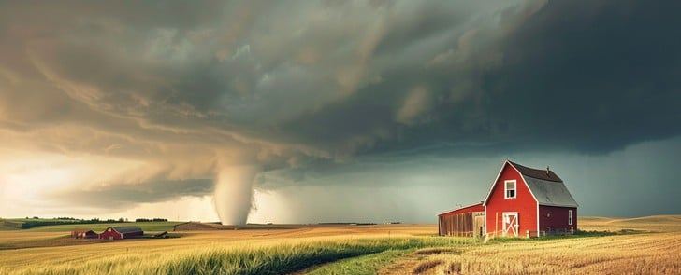

Building Weather Resilient Farming Systems
Image generated with Perplexity
Eric Hunt, PhD
Assistant Extension Educator
UNL Agricultural Meteorology and Climate Resilience
ehunt2@unl.edu | Ph. 402-617-4190

Slide 2
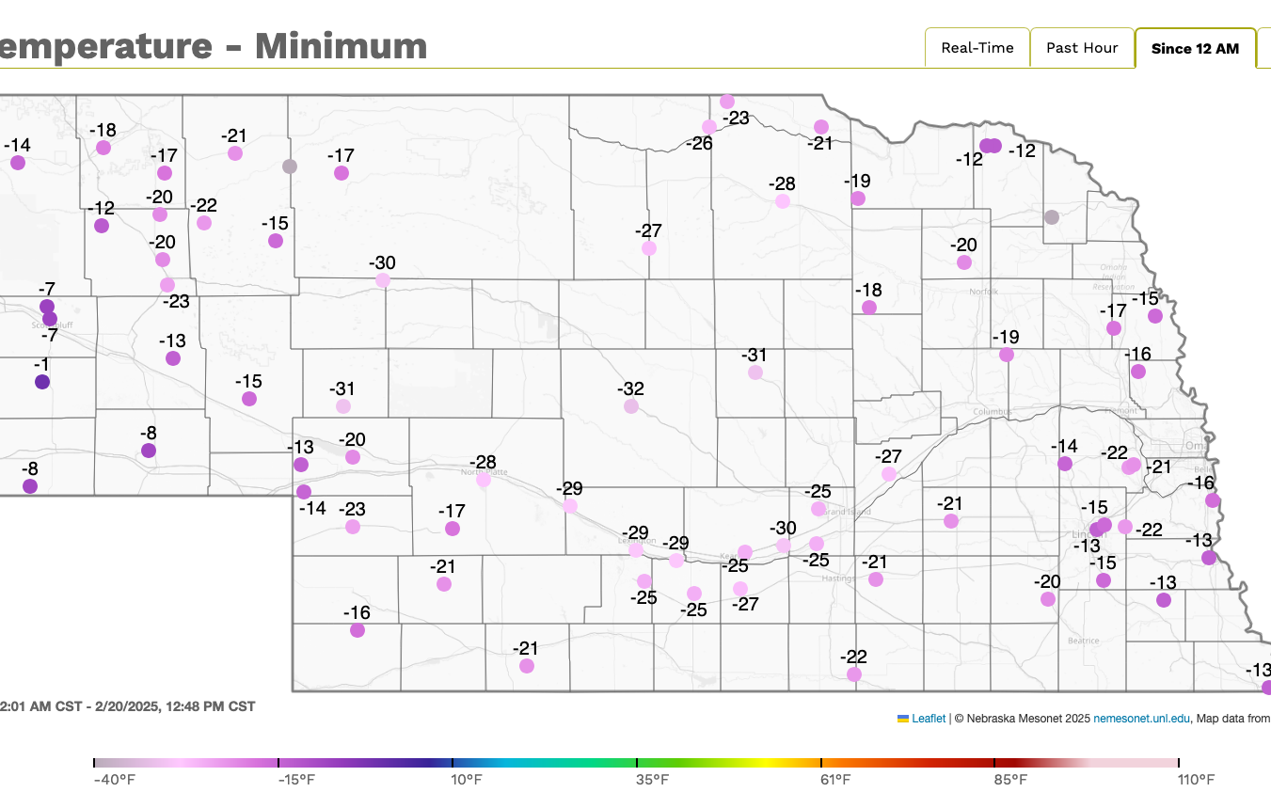
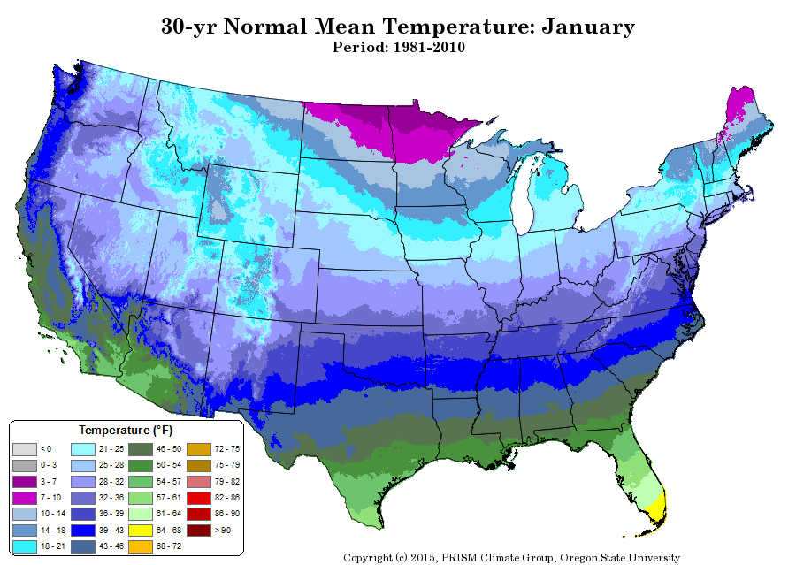
Weather vs. Climate
Real-time maps
Nebraska Mesonet, 2025
Weather is what I’m wearing today, climate is the clothes in my closet.
Weather is you're at bat, climate is your batting average.
Weather is your mood, climate is your personality.
PRISM Oregon State University, 2025

Slide 3
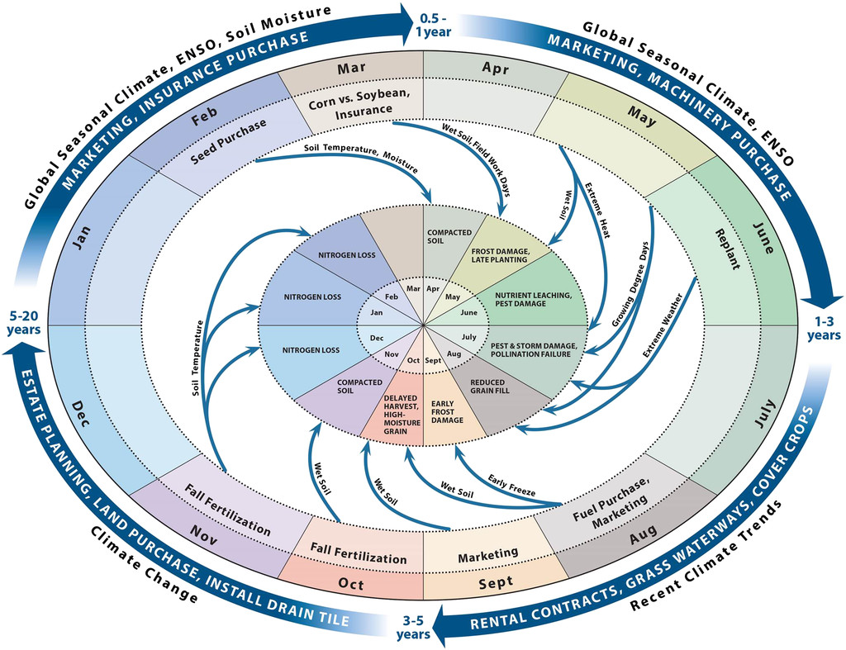
February-March
NEBRASKA STATE CLIMATE OFFICE
Takle et al., 2014

Slide 4
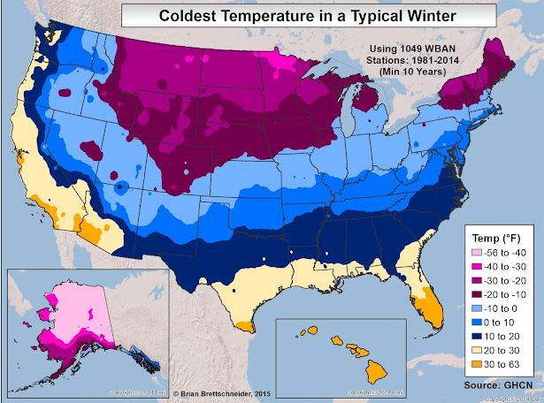
Coldest Winter Temperatures
NEBRASKA STATE CLIMATE OFFICE
Source, GHCN

Slide 5
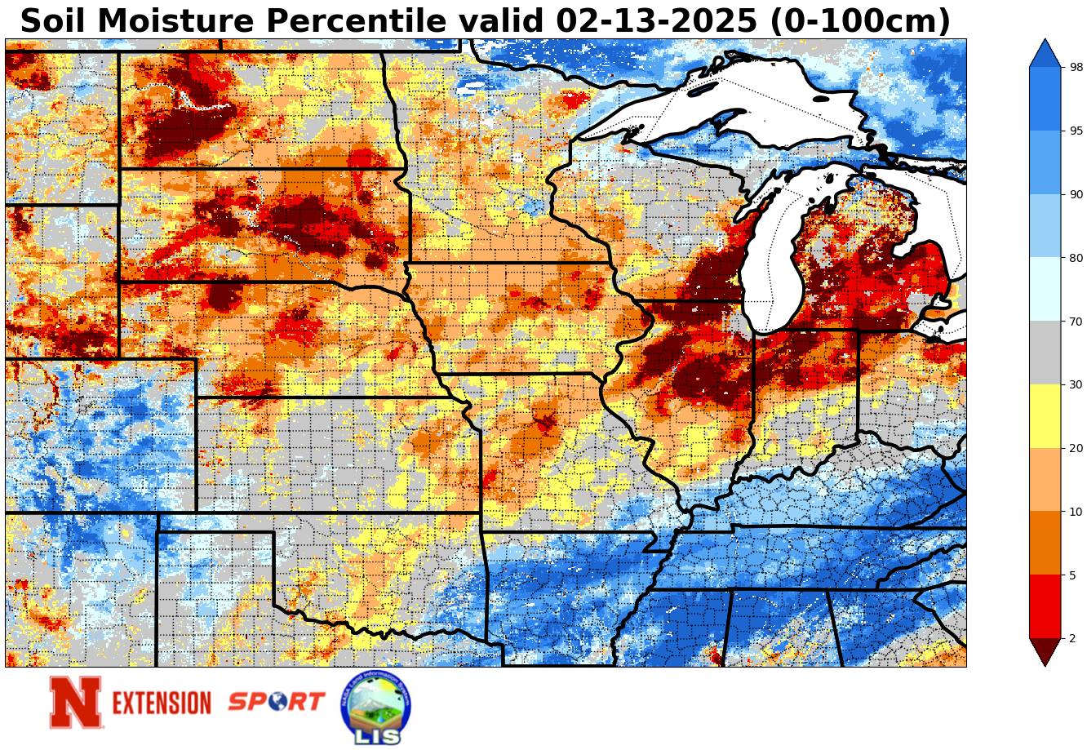
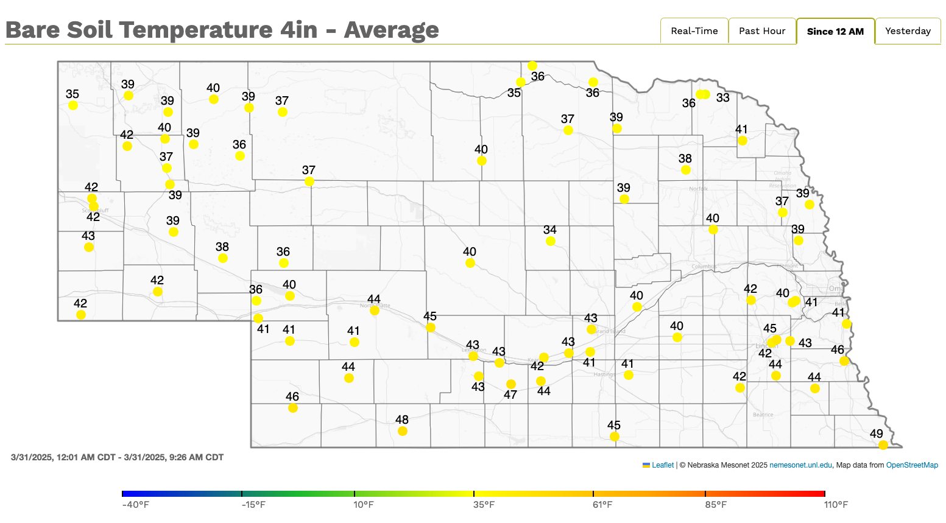
Soil Moisture and Soil Temperature
NEBRASKA STATE CLIMATE OFFICE
Source, NASA
Source, Nebraska Mesonet

Slide 6
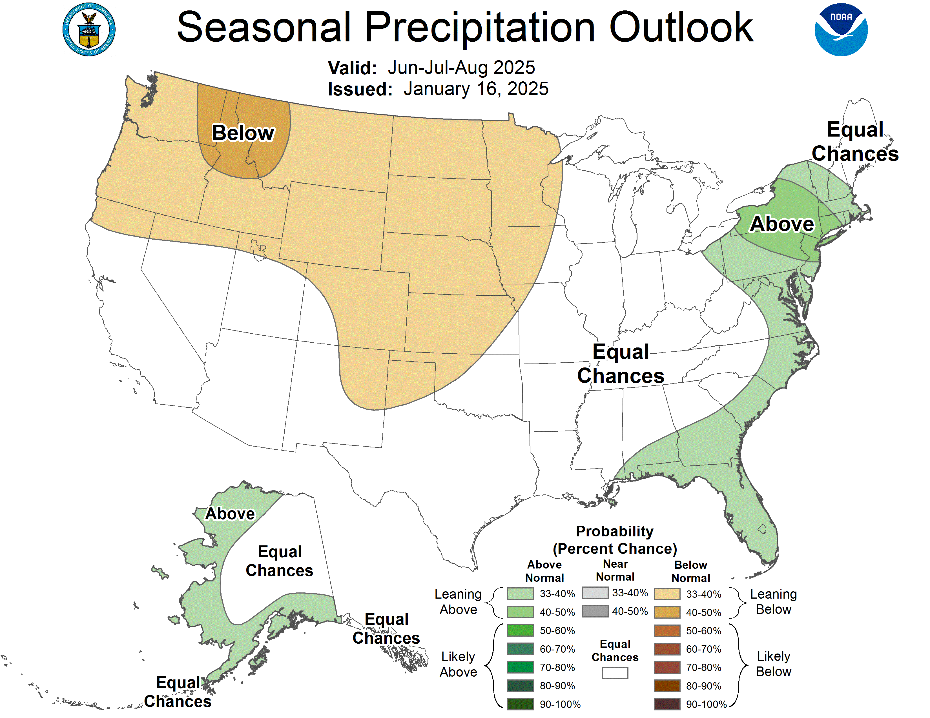
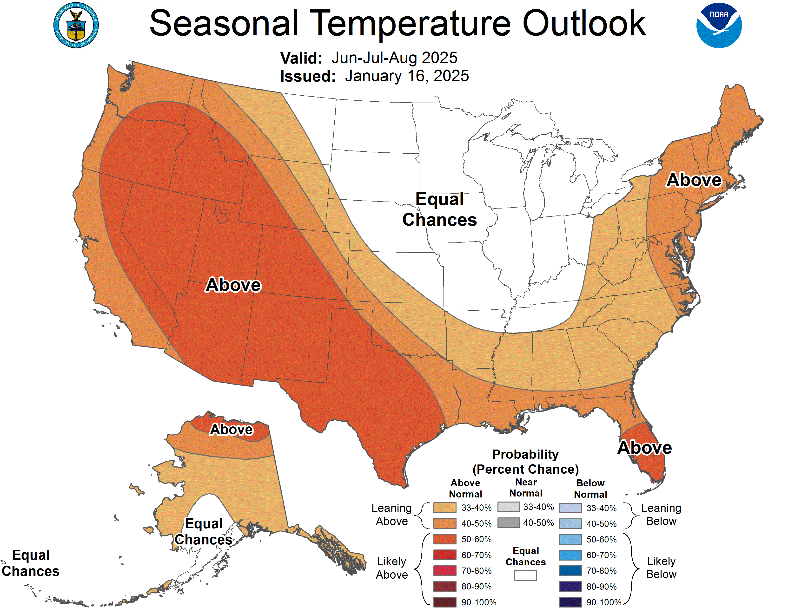
CPC Summer Outlook (from Feb.)
NEBRASKA STATE CLIMATE OFFICE
Source, CPC
Source, CPC

Slide 7
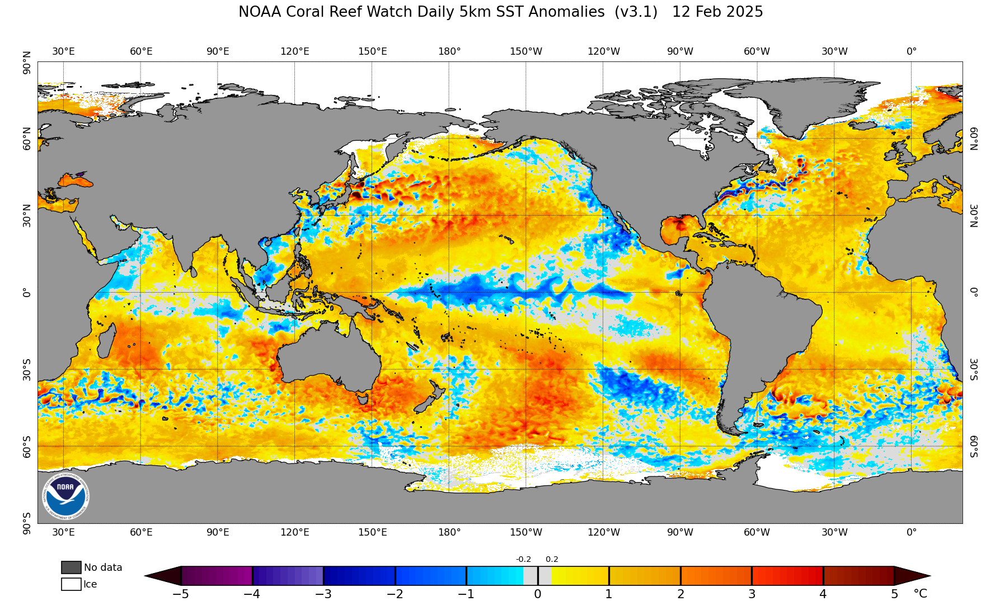





Current Sea Surface Temperatures
NEBRASKA STATE CLIMATE OFFICE
Source, NOAA

Slide 8
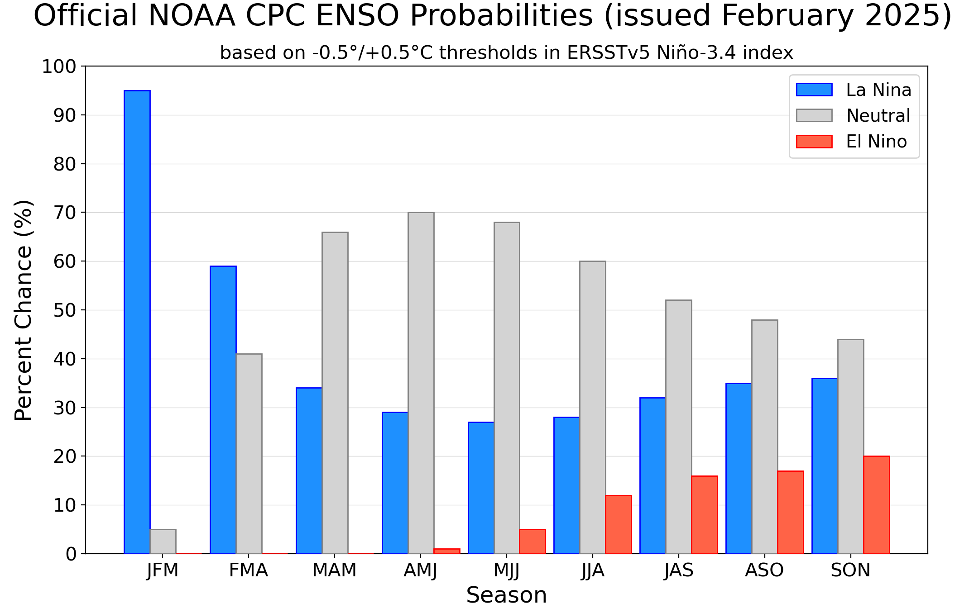
ENSO forecast
NEBRASKA STATE CLIMATE OFFICE
Source, NOAA

Slide 9
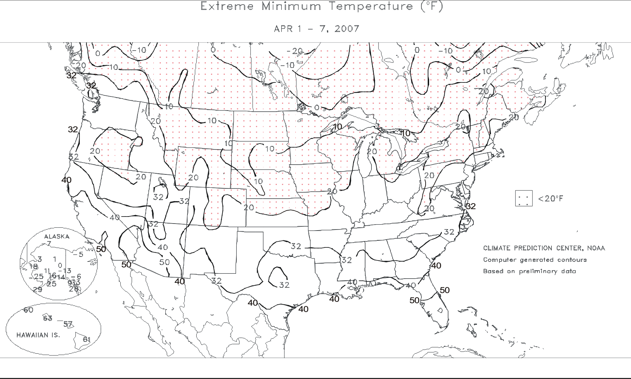
April-May
NEBRASKA STATE CLIMATE OFFICE
Source, USDA and CPC

Slide 10
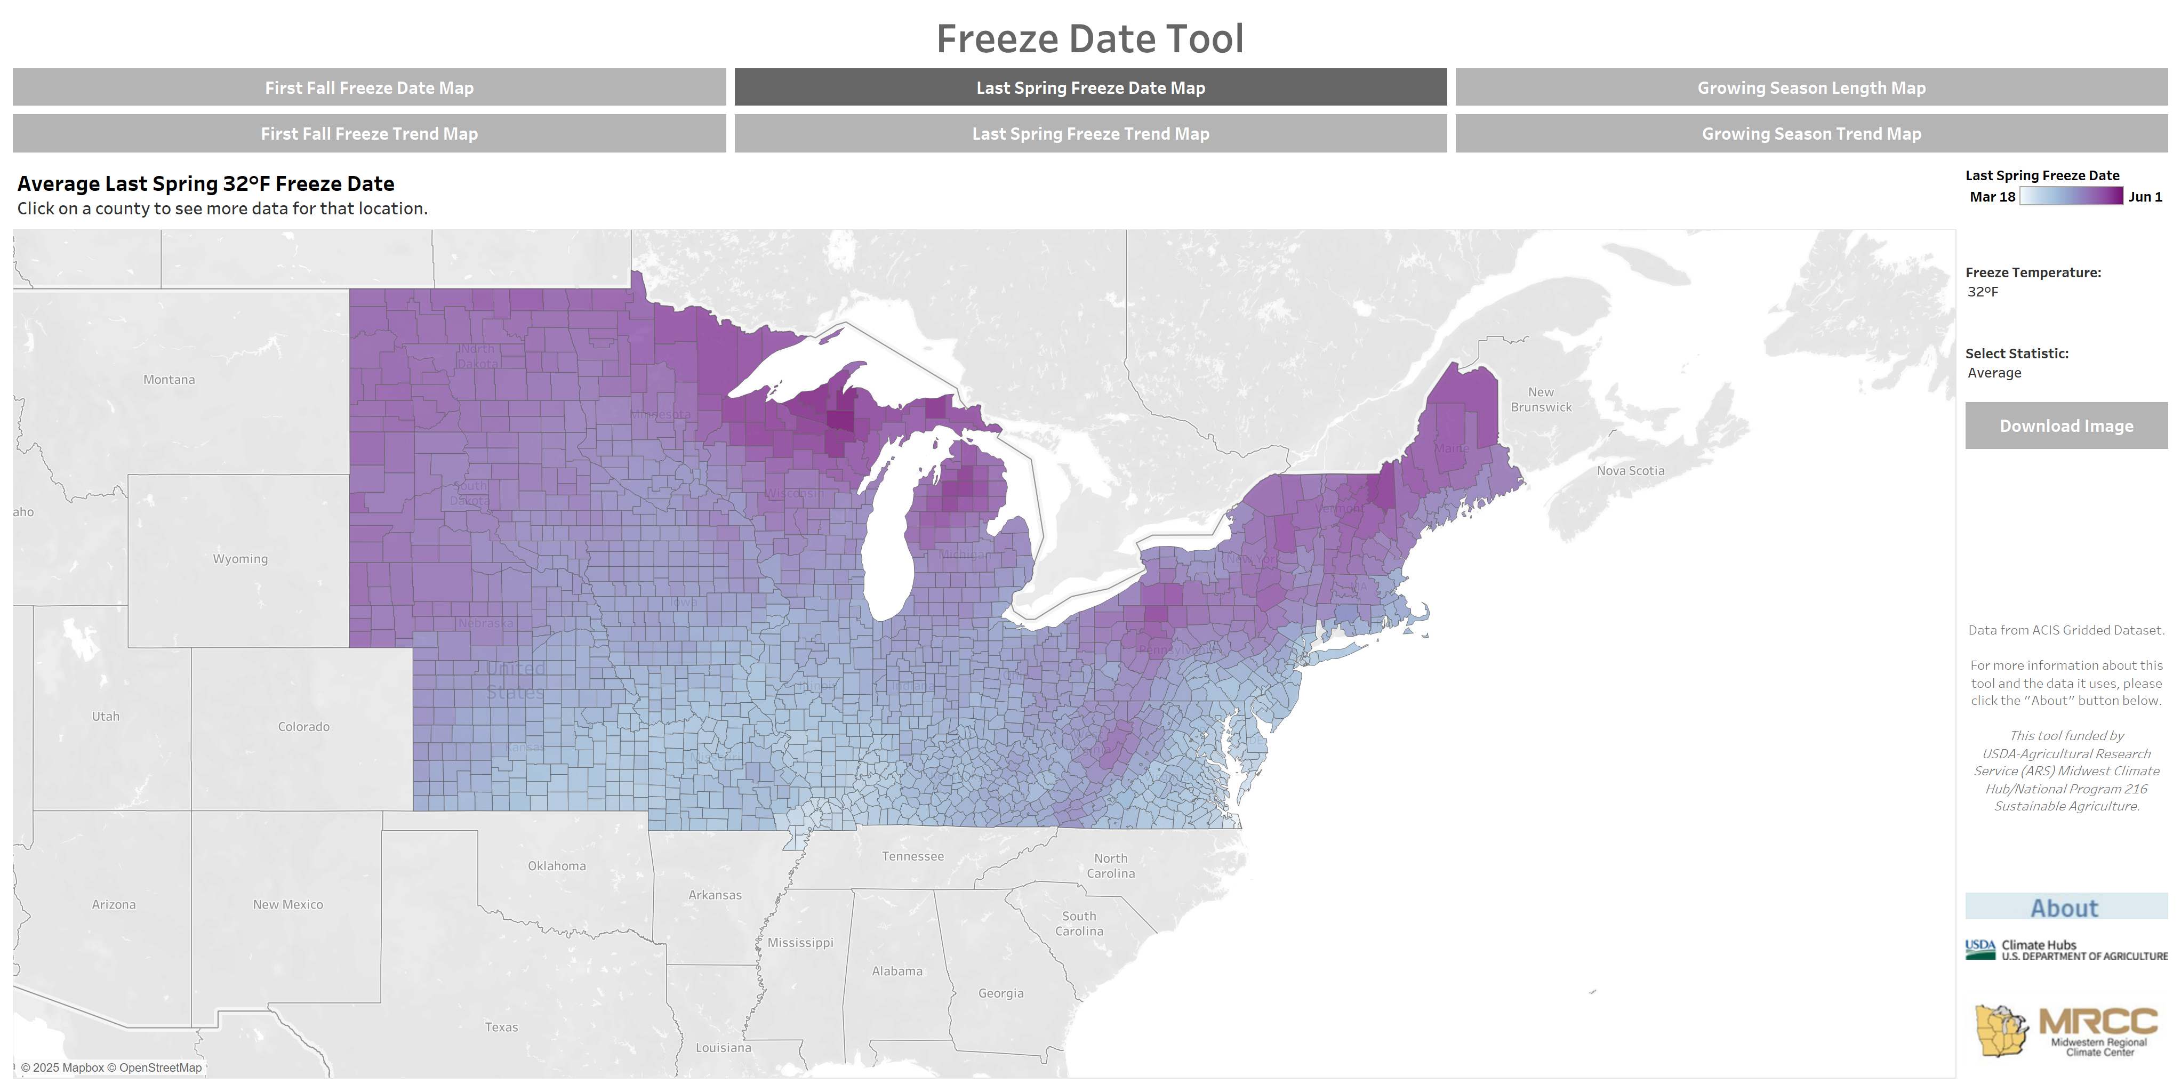
Frost Freeze Toolkit
NEBRASKA STATE CLIMATE OFFICE
MRCC Purdue, 2025

Slide 11
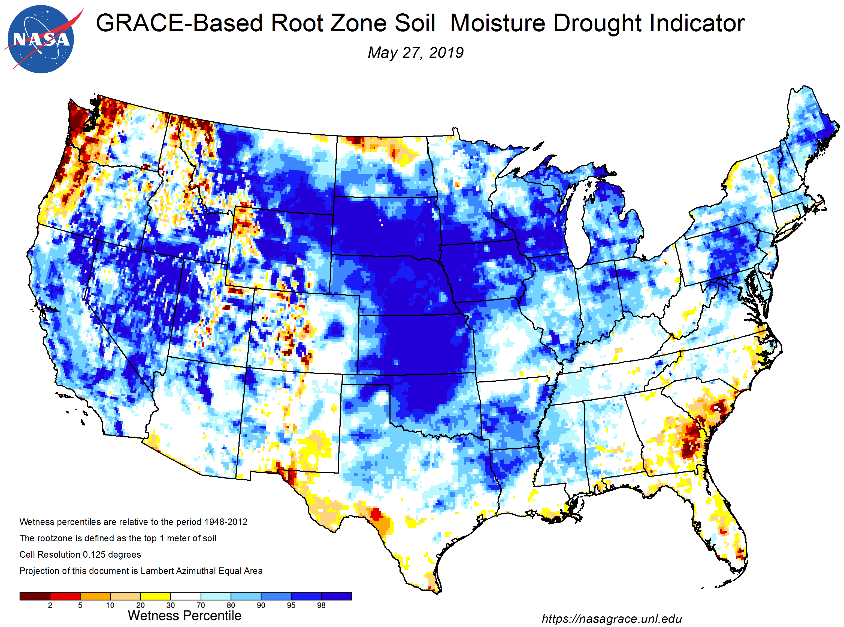
April-May
NEBRASKA STATE CLIMATE OFFICE
Source, NASA

Slide 12
Summer
NEBRASKA STATE CLIMATE OFFICE
Source, Takle et al. (2014)

Slide 13
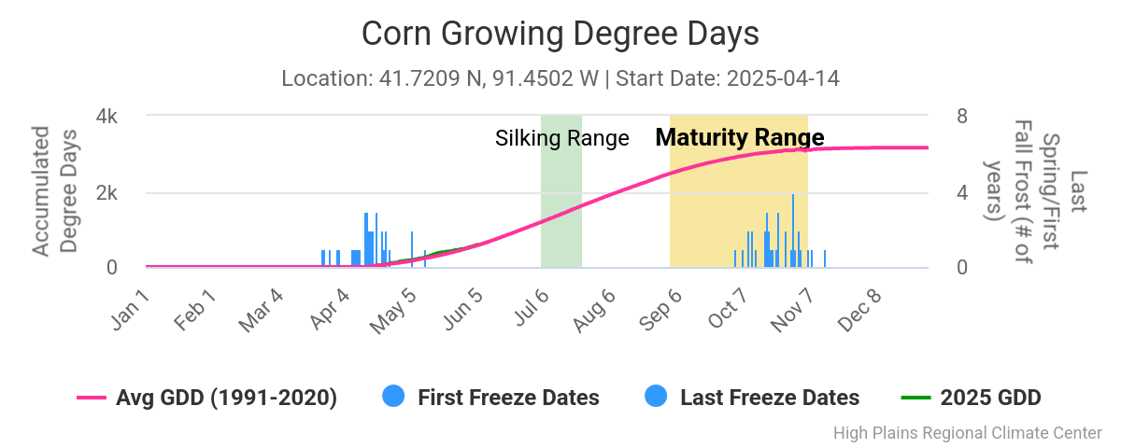
Growing Degree Days
NEBRASKA STATE CLIMATE OFFICE
HPRCC UNL, 2025

Slide 14
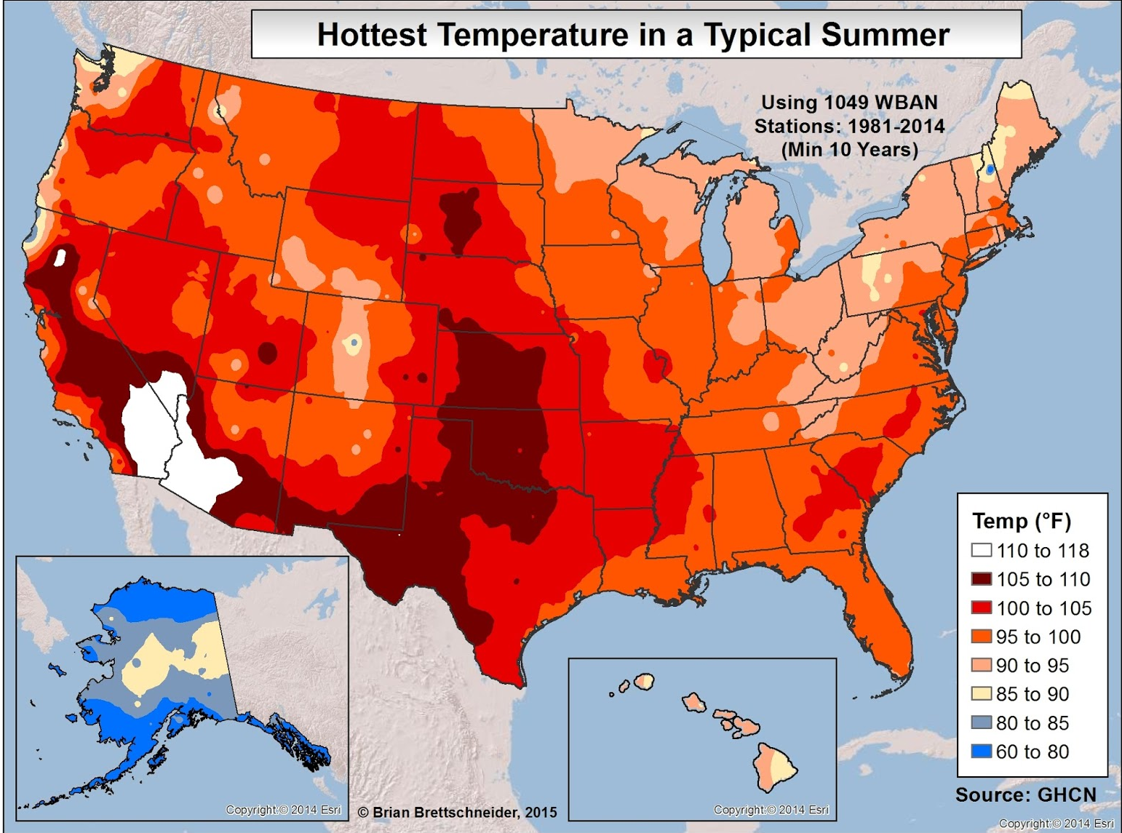
Hottest Summer Temperatures
NEBRASKA STATE CLIMATE OFFICE
Source, GHCN

Slide 15
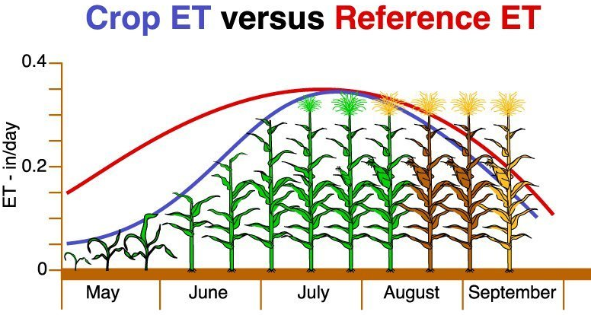
Potential Evapotranspiration (ET)
NEBRASKA STATE CLIMATE OFFICE
FAO, 2025

Slide 16
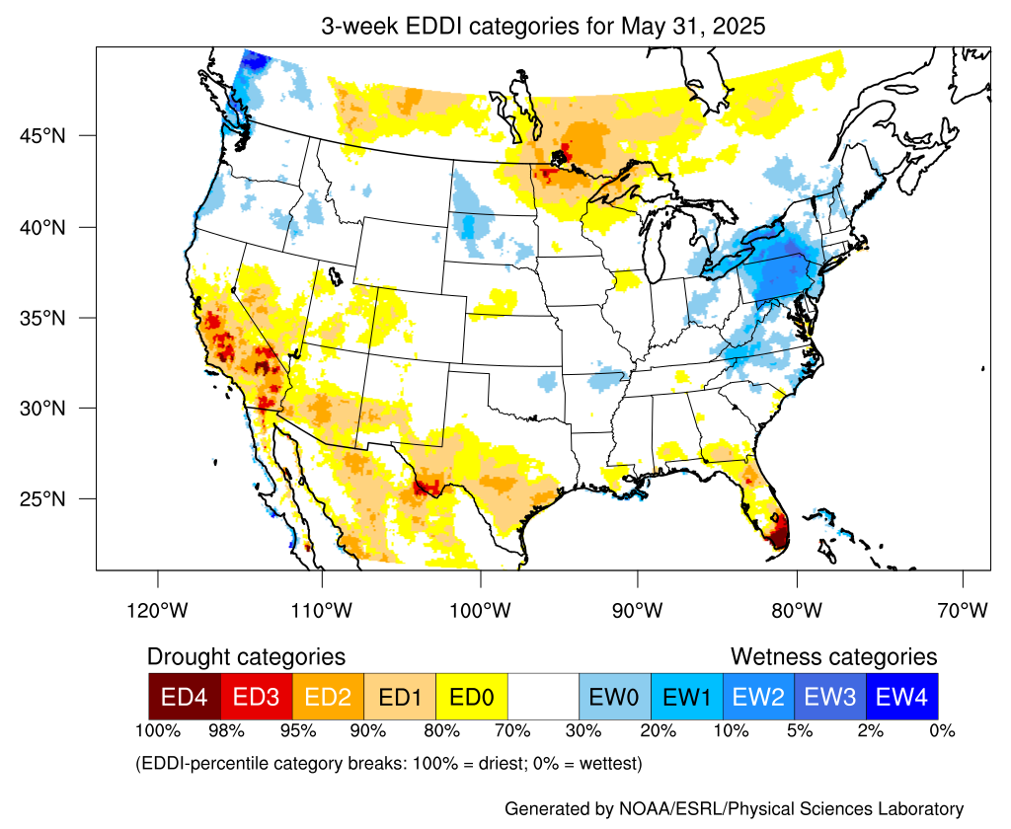
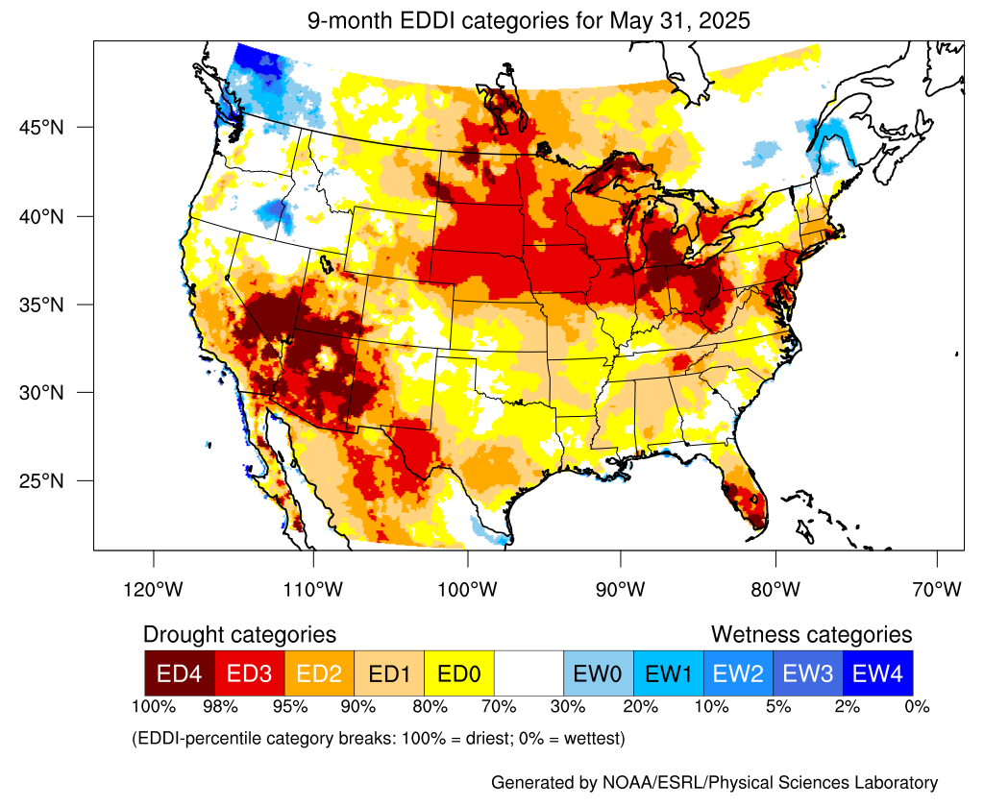
Evaporative Demand Drought Index
NEBRASKA STATE CLIMATE OFFICE
Source, NOAA
Source, NOAA

Slide 17
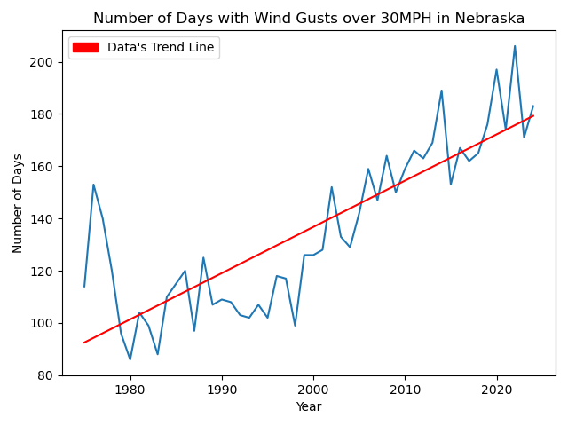
Wind
NEBRASKA STATE CLIMATE OFFICE
Source, ACIS

Slide 18
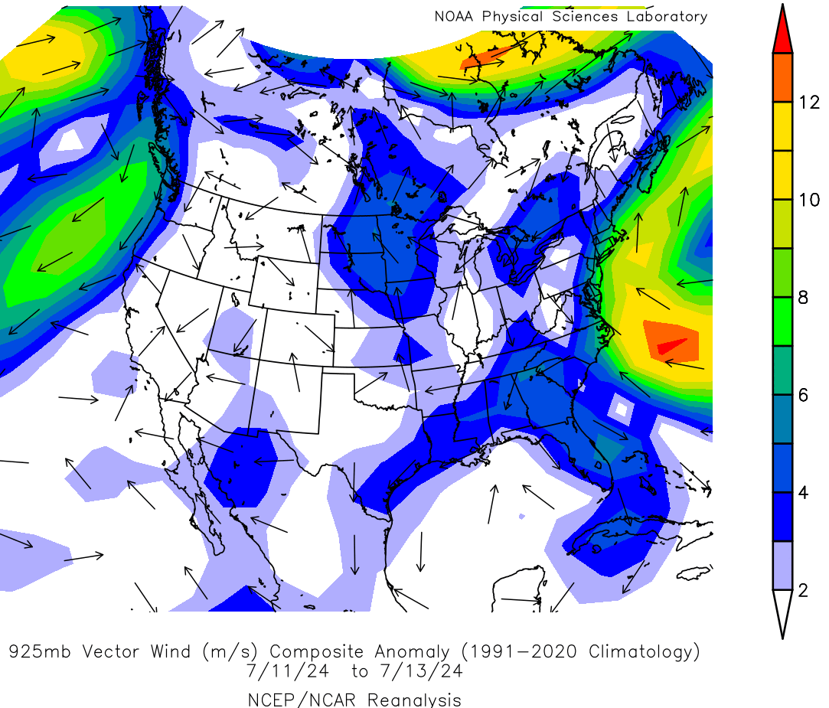
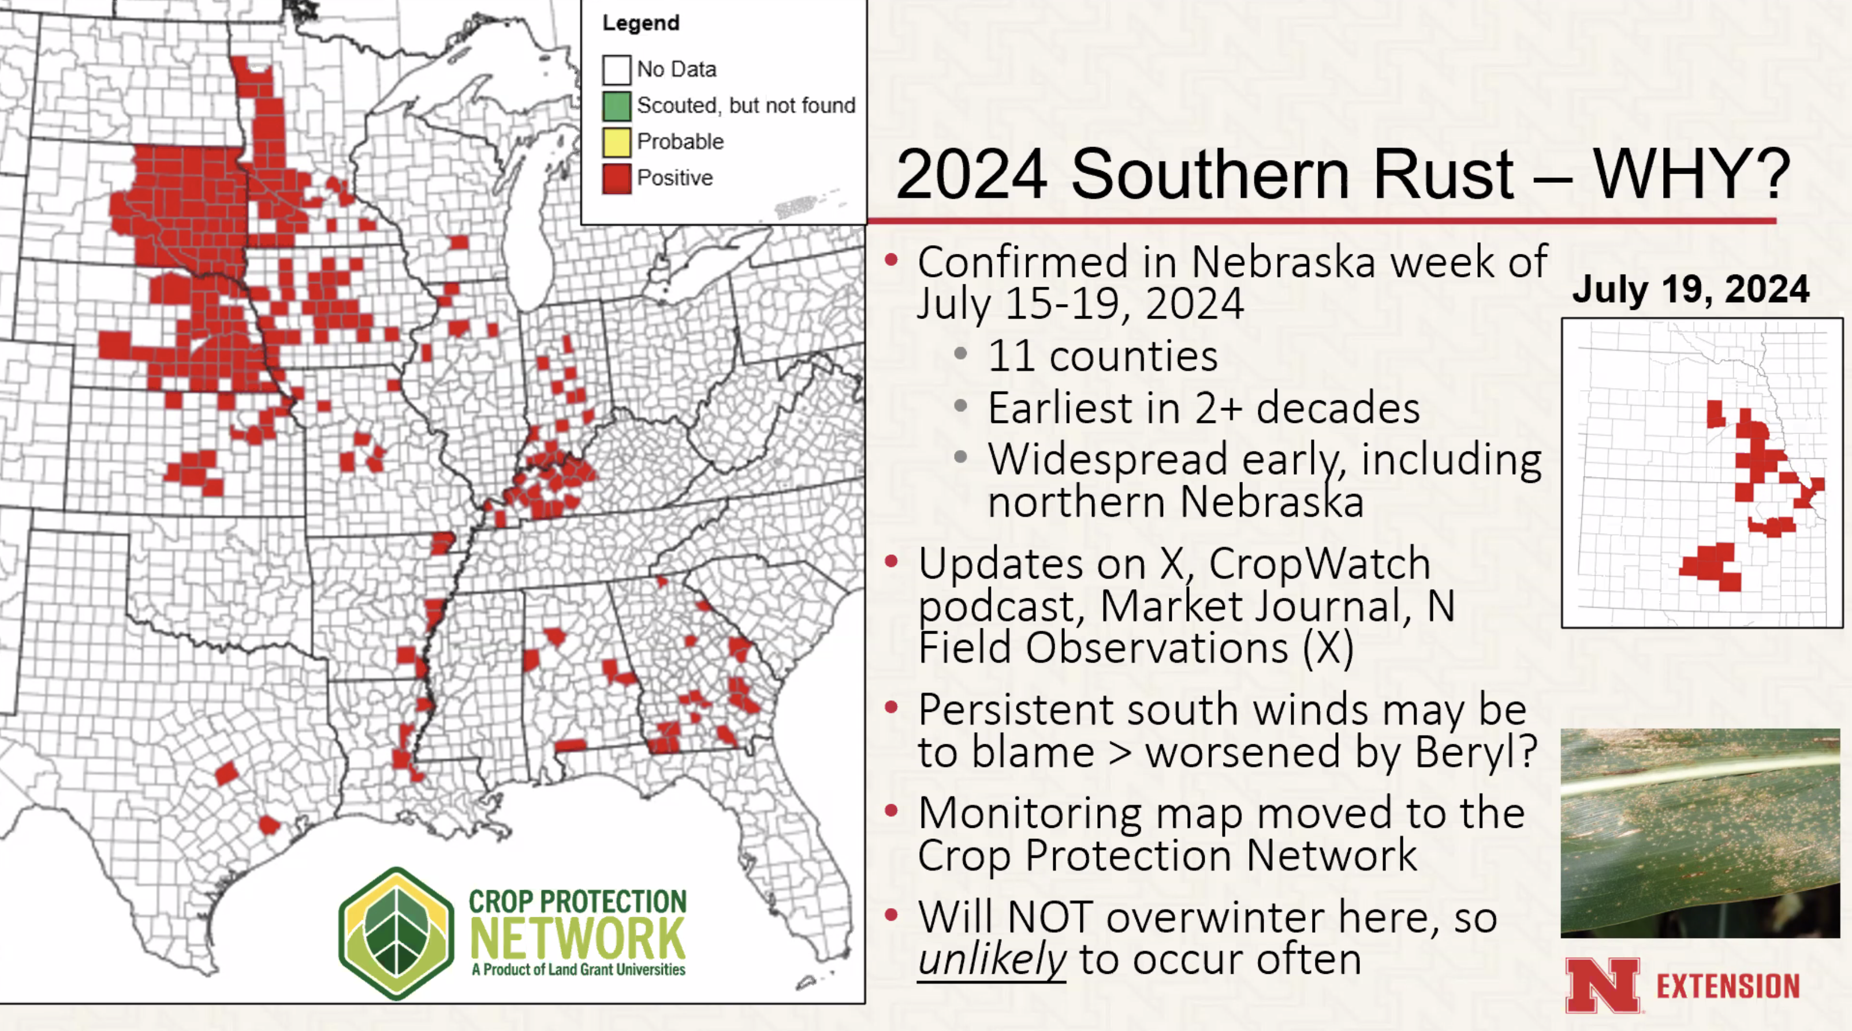
Disease Issues
NEBRASKA STATE CLIMATE OFFICE
Source, Crop Protection Network
Source, NOAA

Slide 19
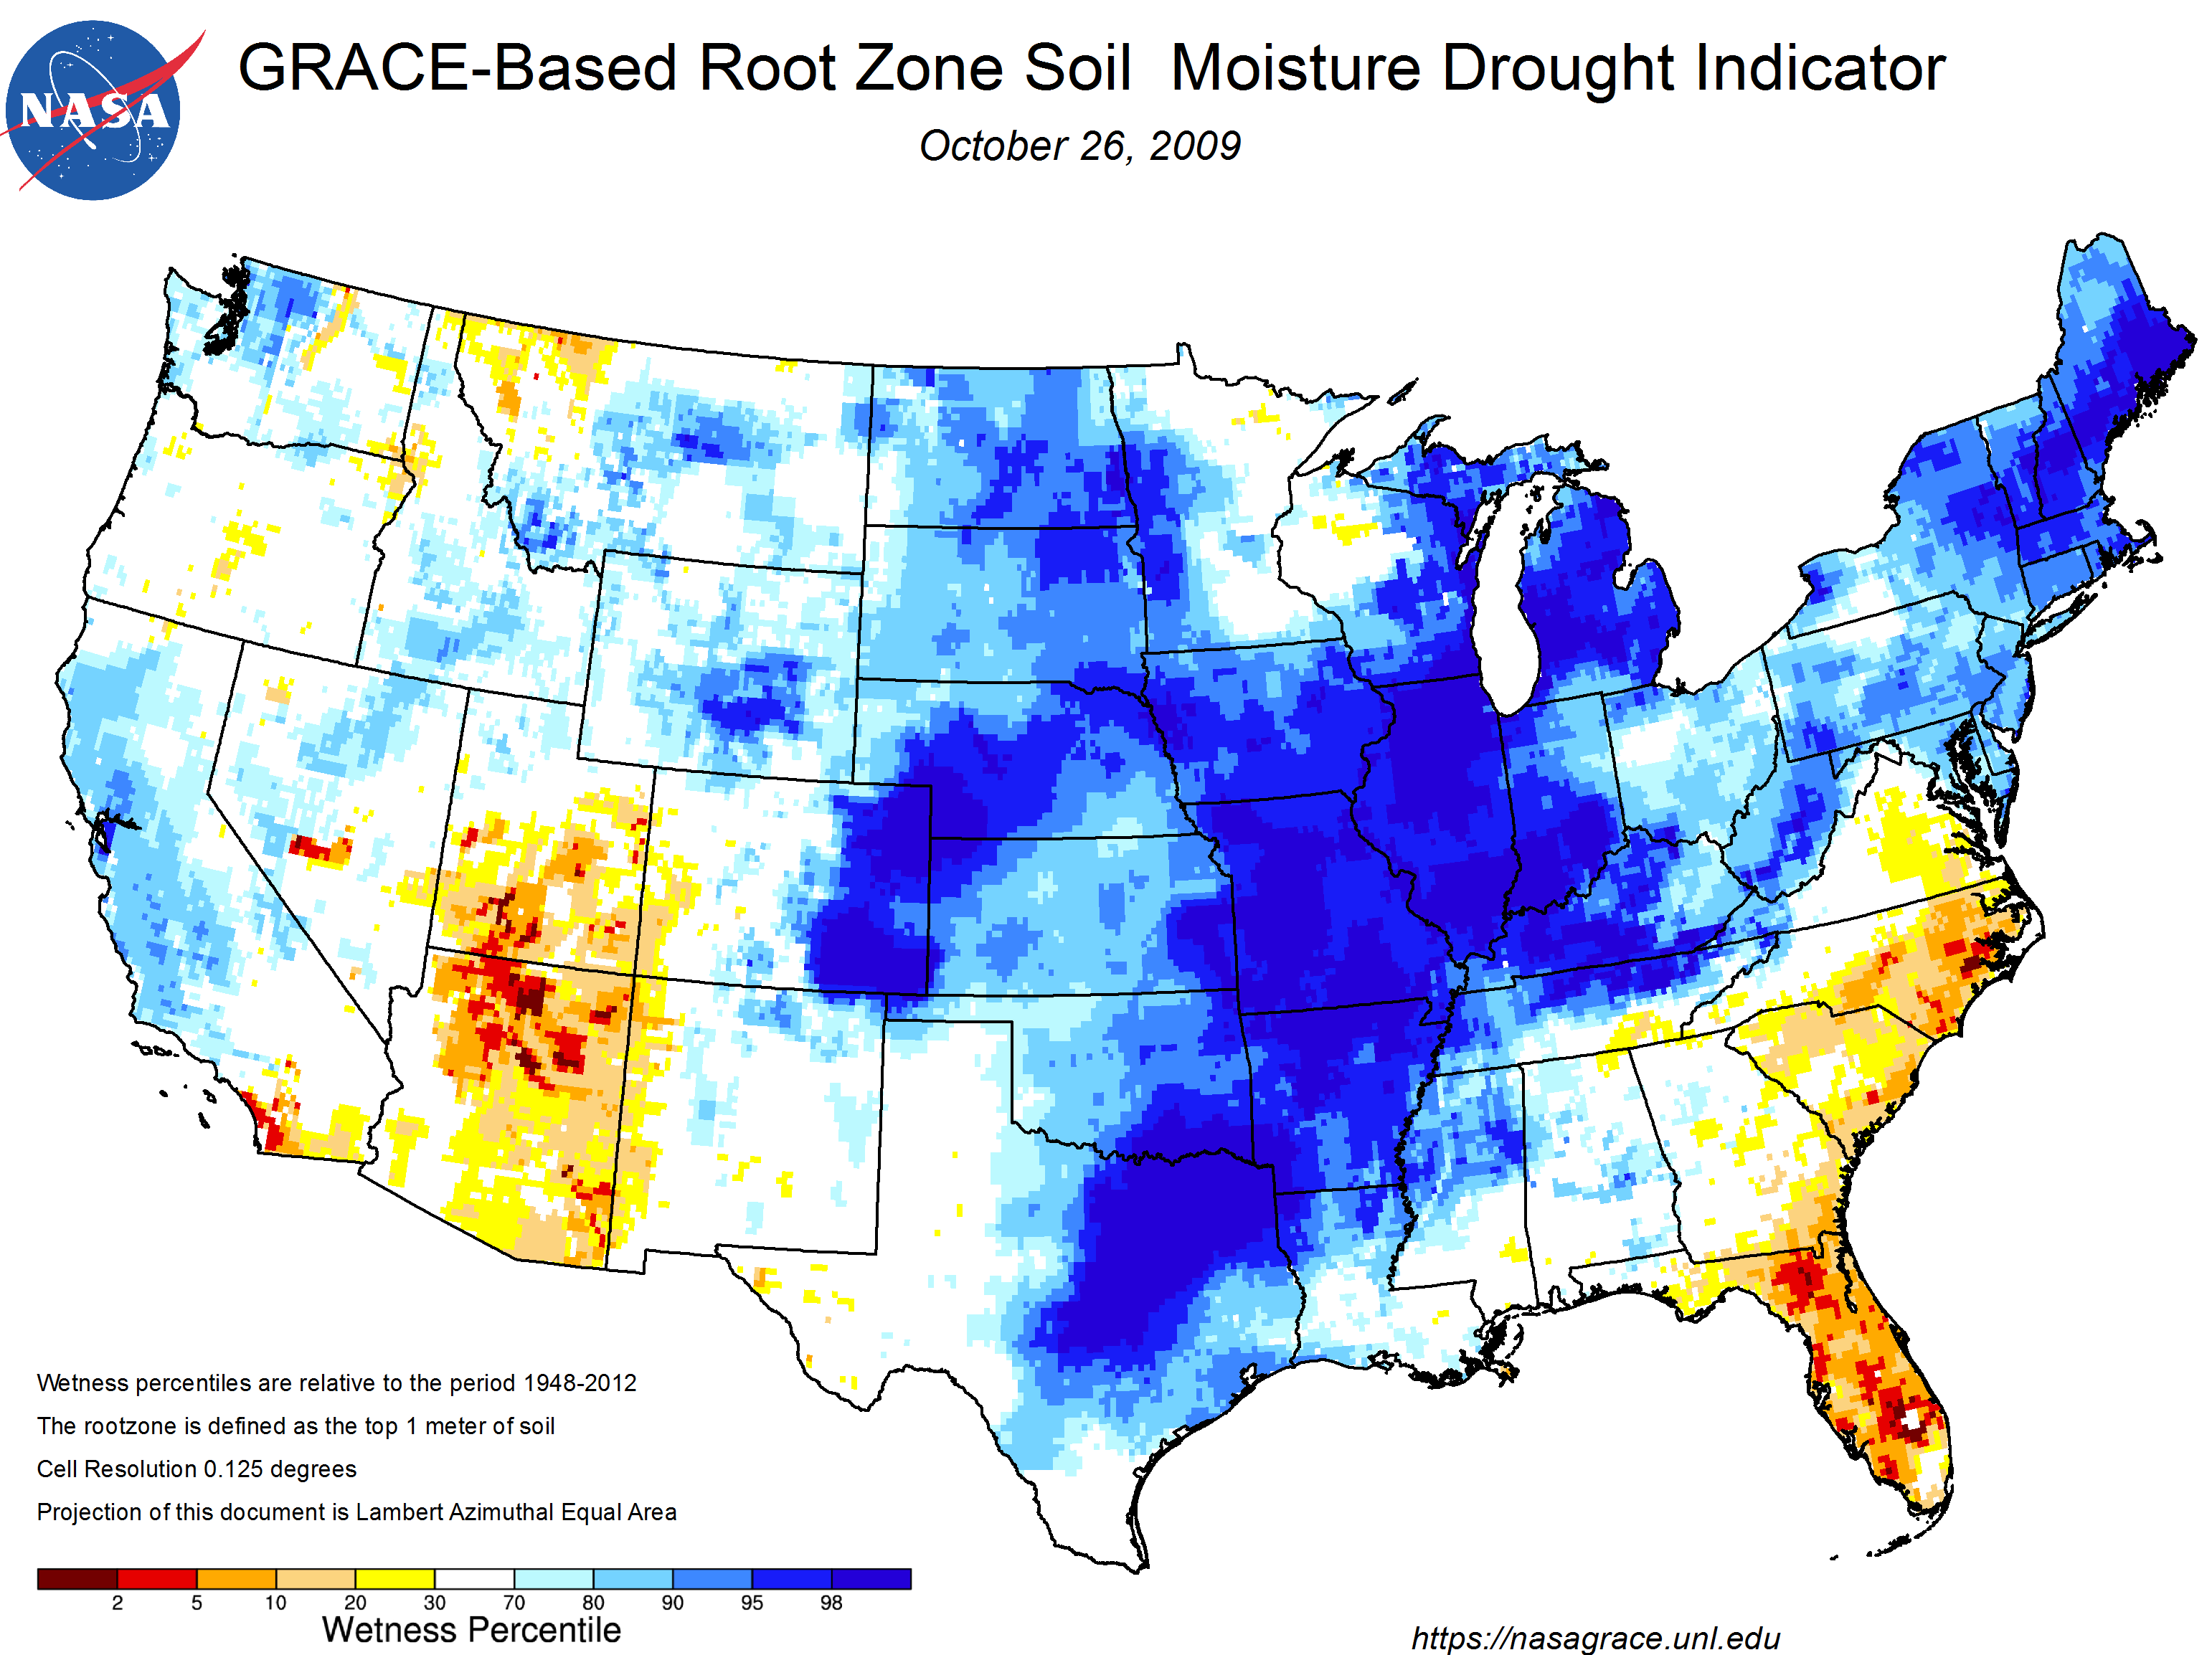
Fall
NEBRASKA STATE CLIMATE OFFICE
Source, NASA
Source, Takle et al. (2014)

Slide 20
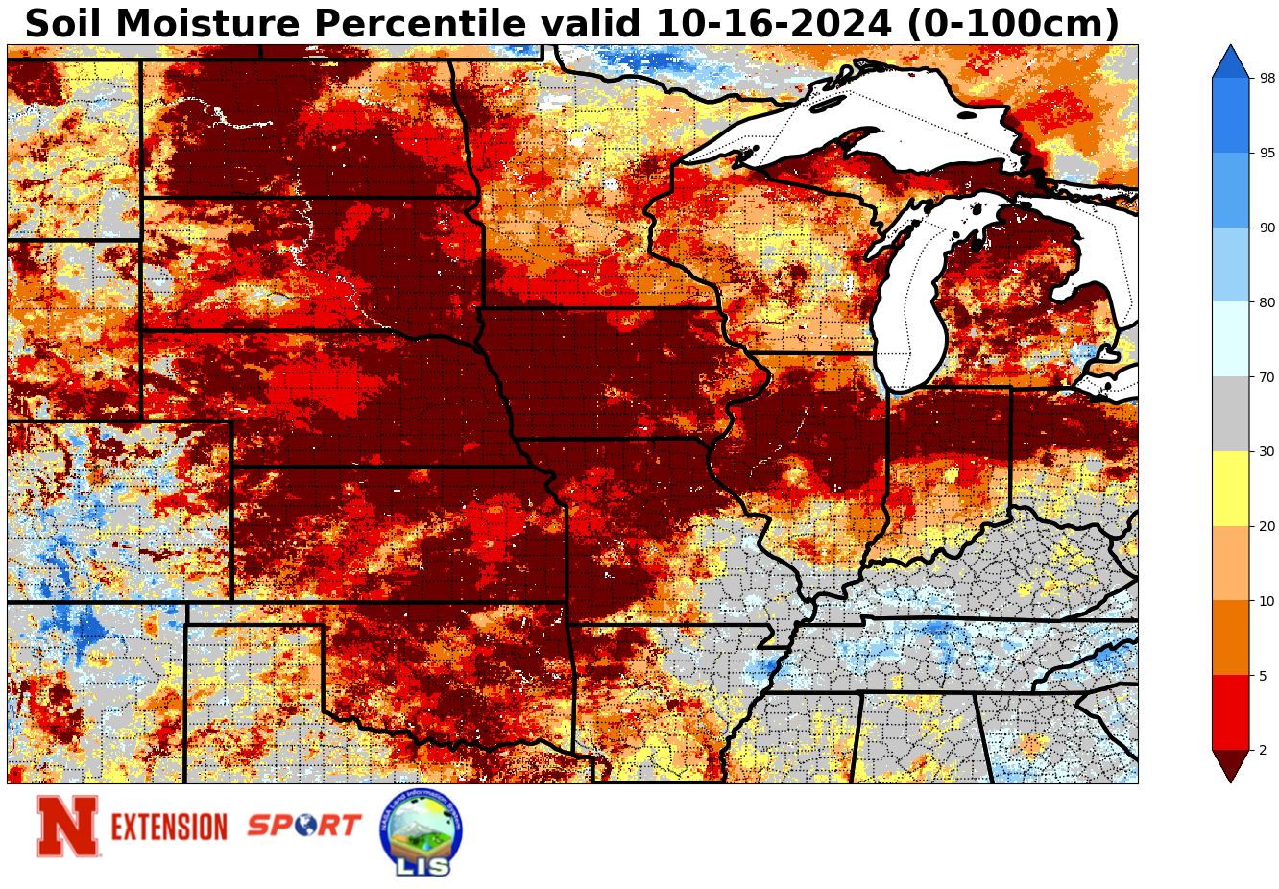
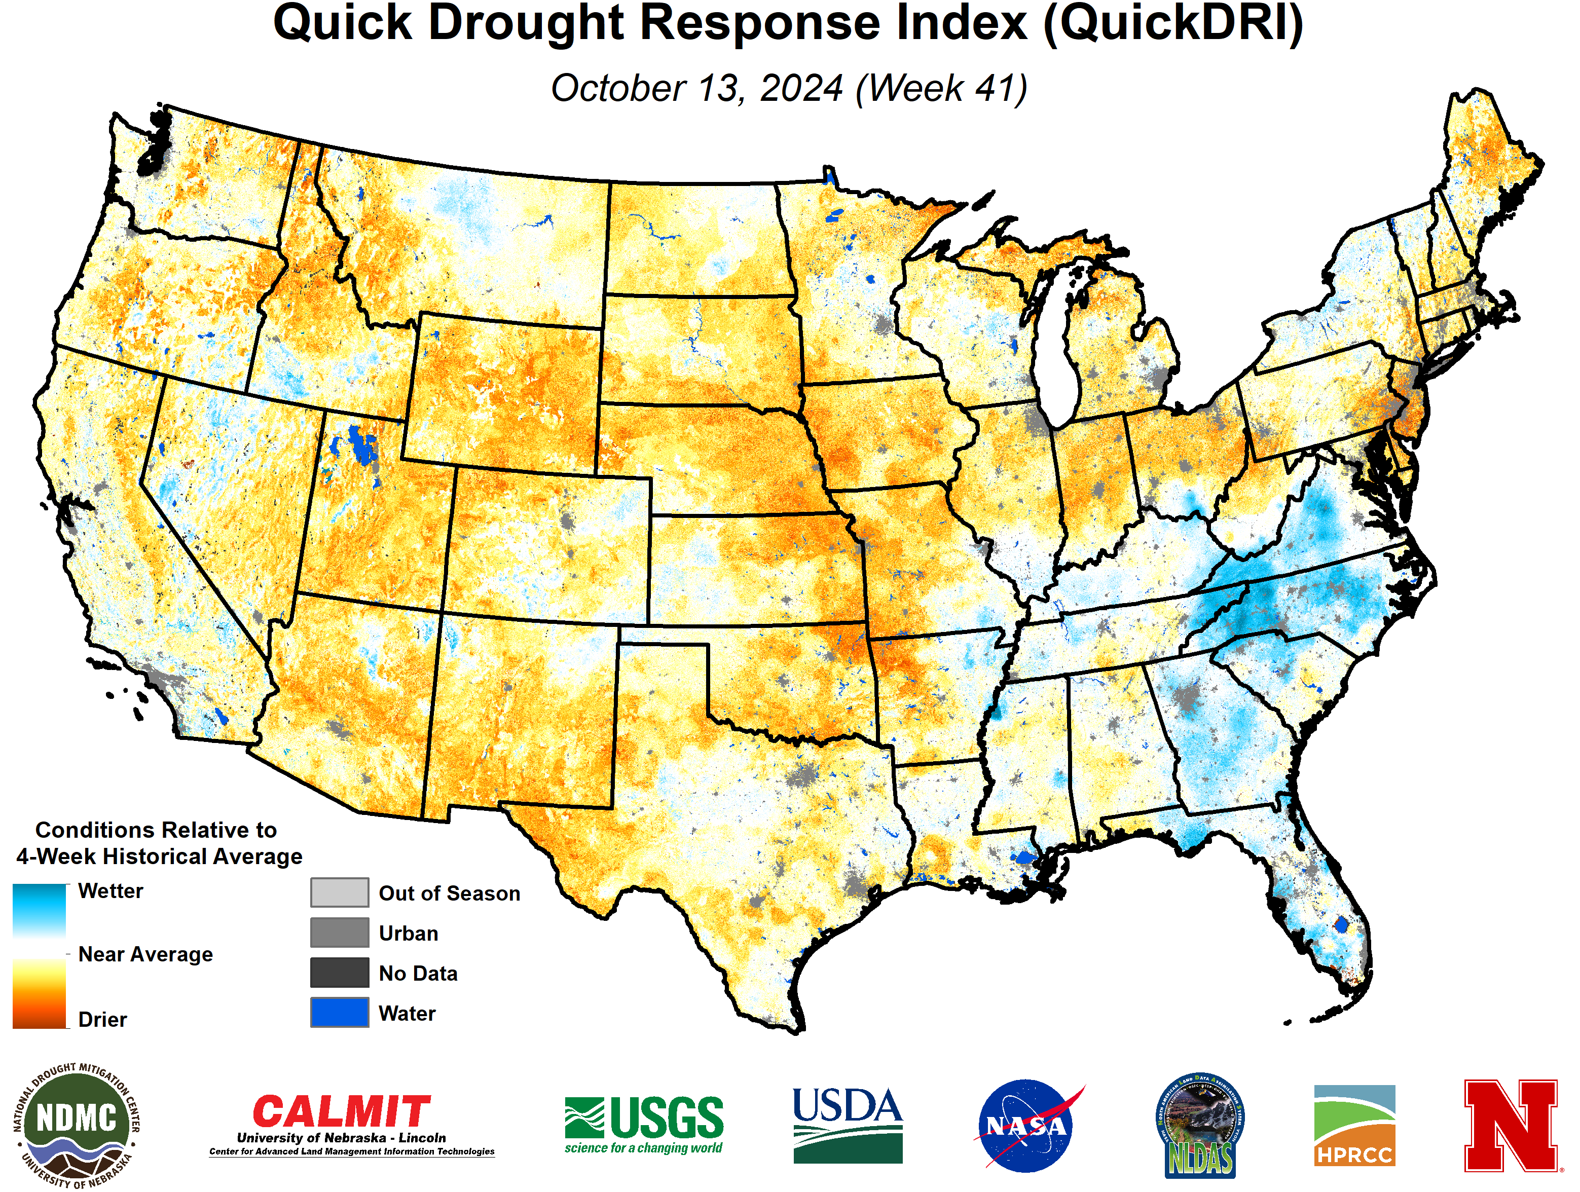
Soil Moisture and Vegetation Health
NEBRASKA STATE CLIMATE OFFICE
Source, NASA
Source, UNL

Slide 21
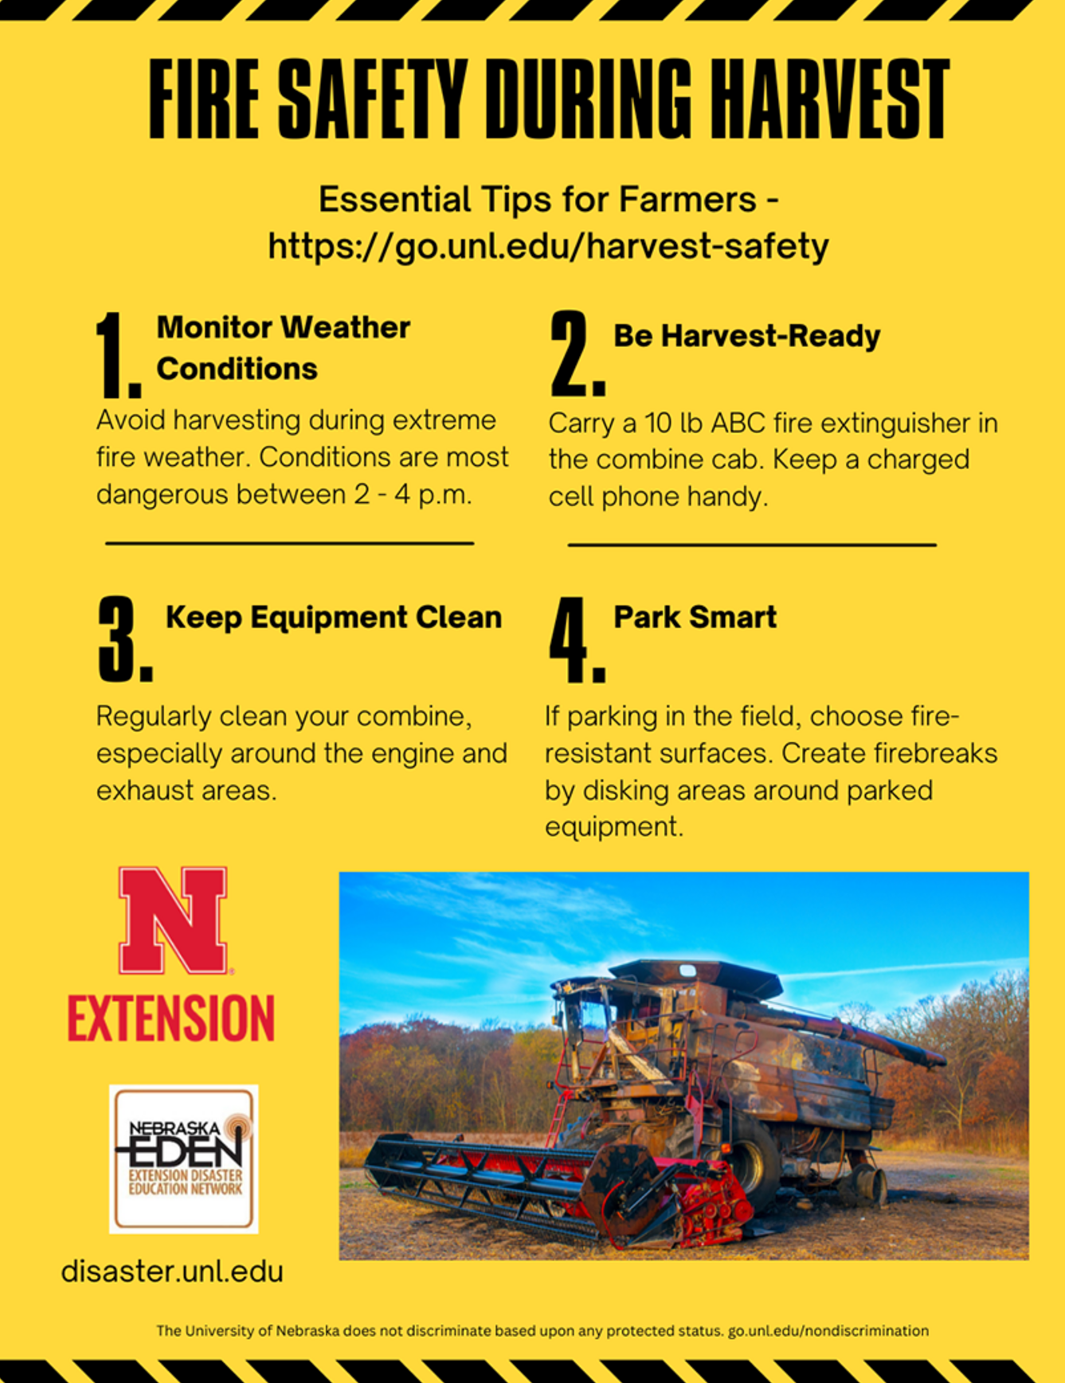
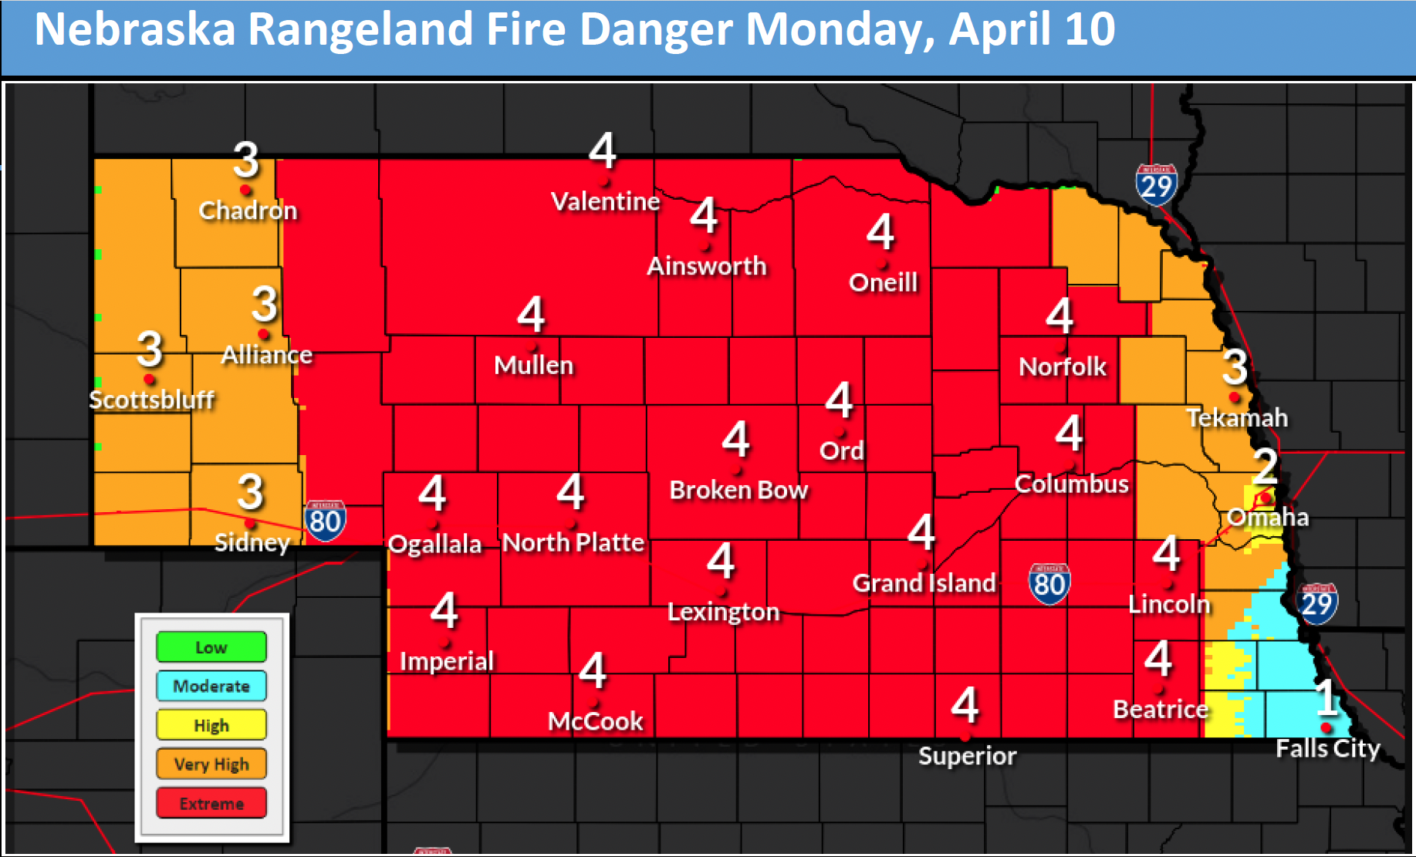
Fire Safety
UNL CropWatch, 2025
NEBRASKA STATE CLIMATE OFFICE
Source, NEMA

Slide 22
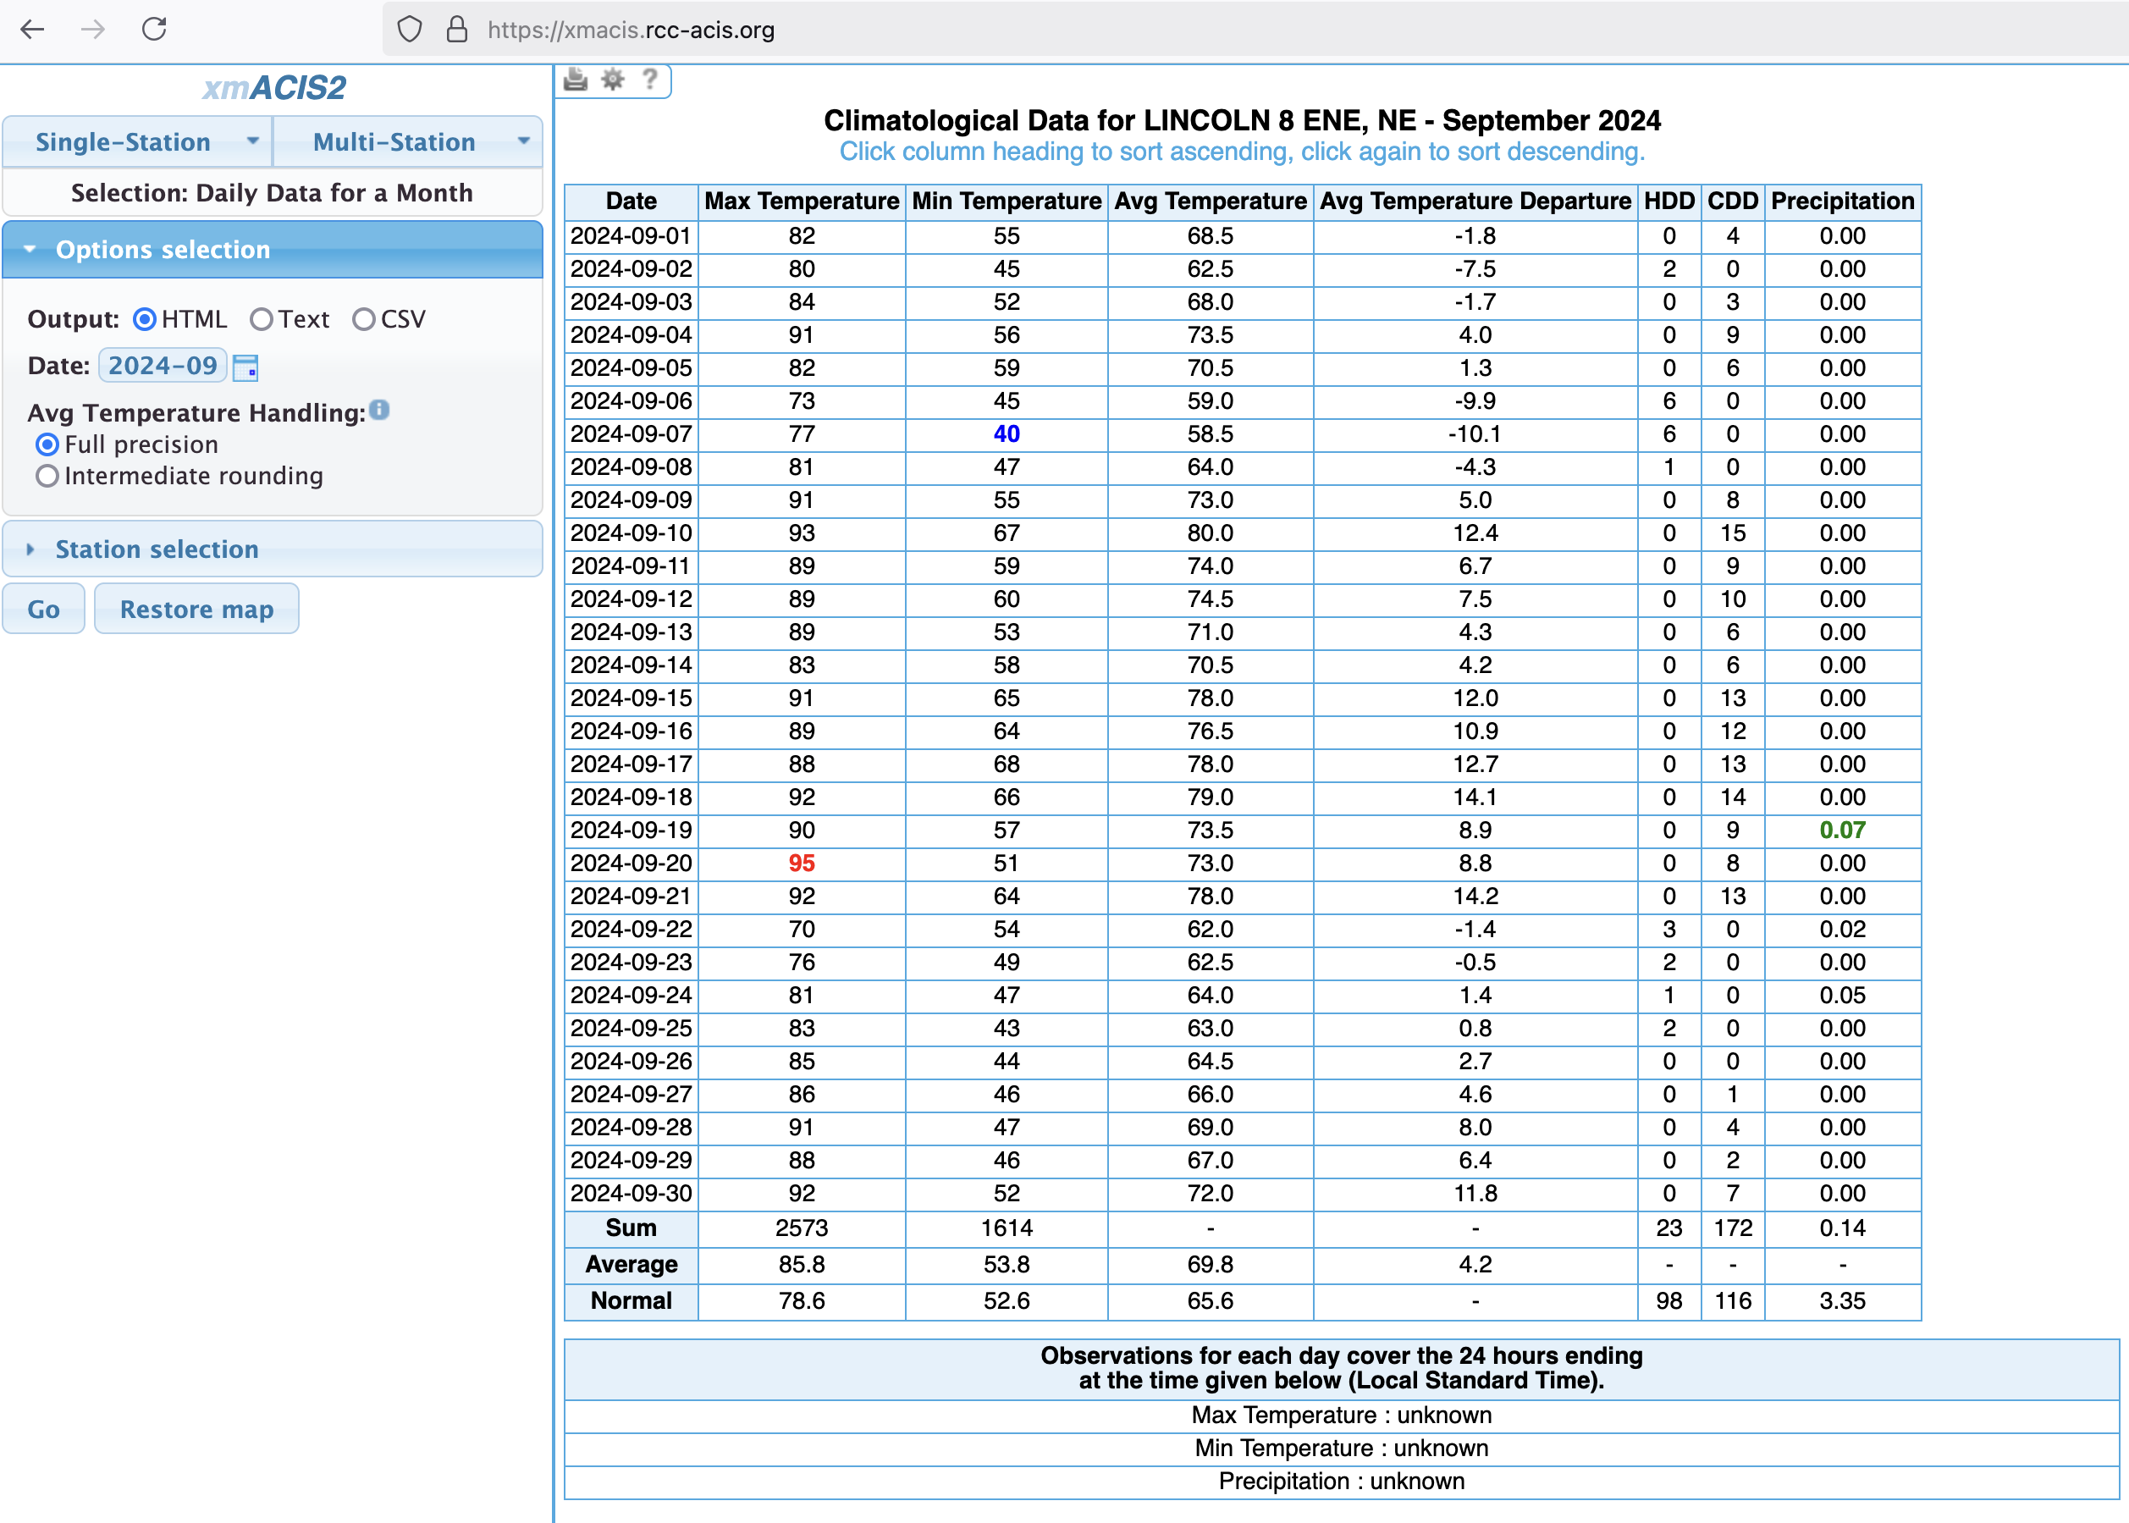
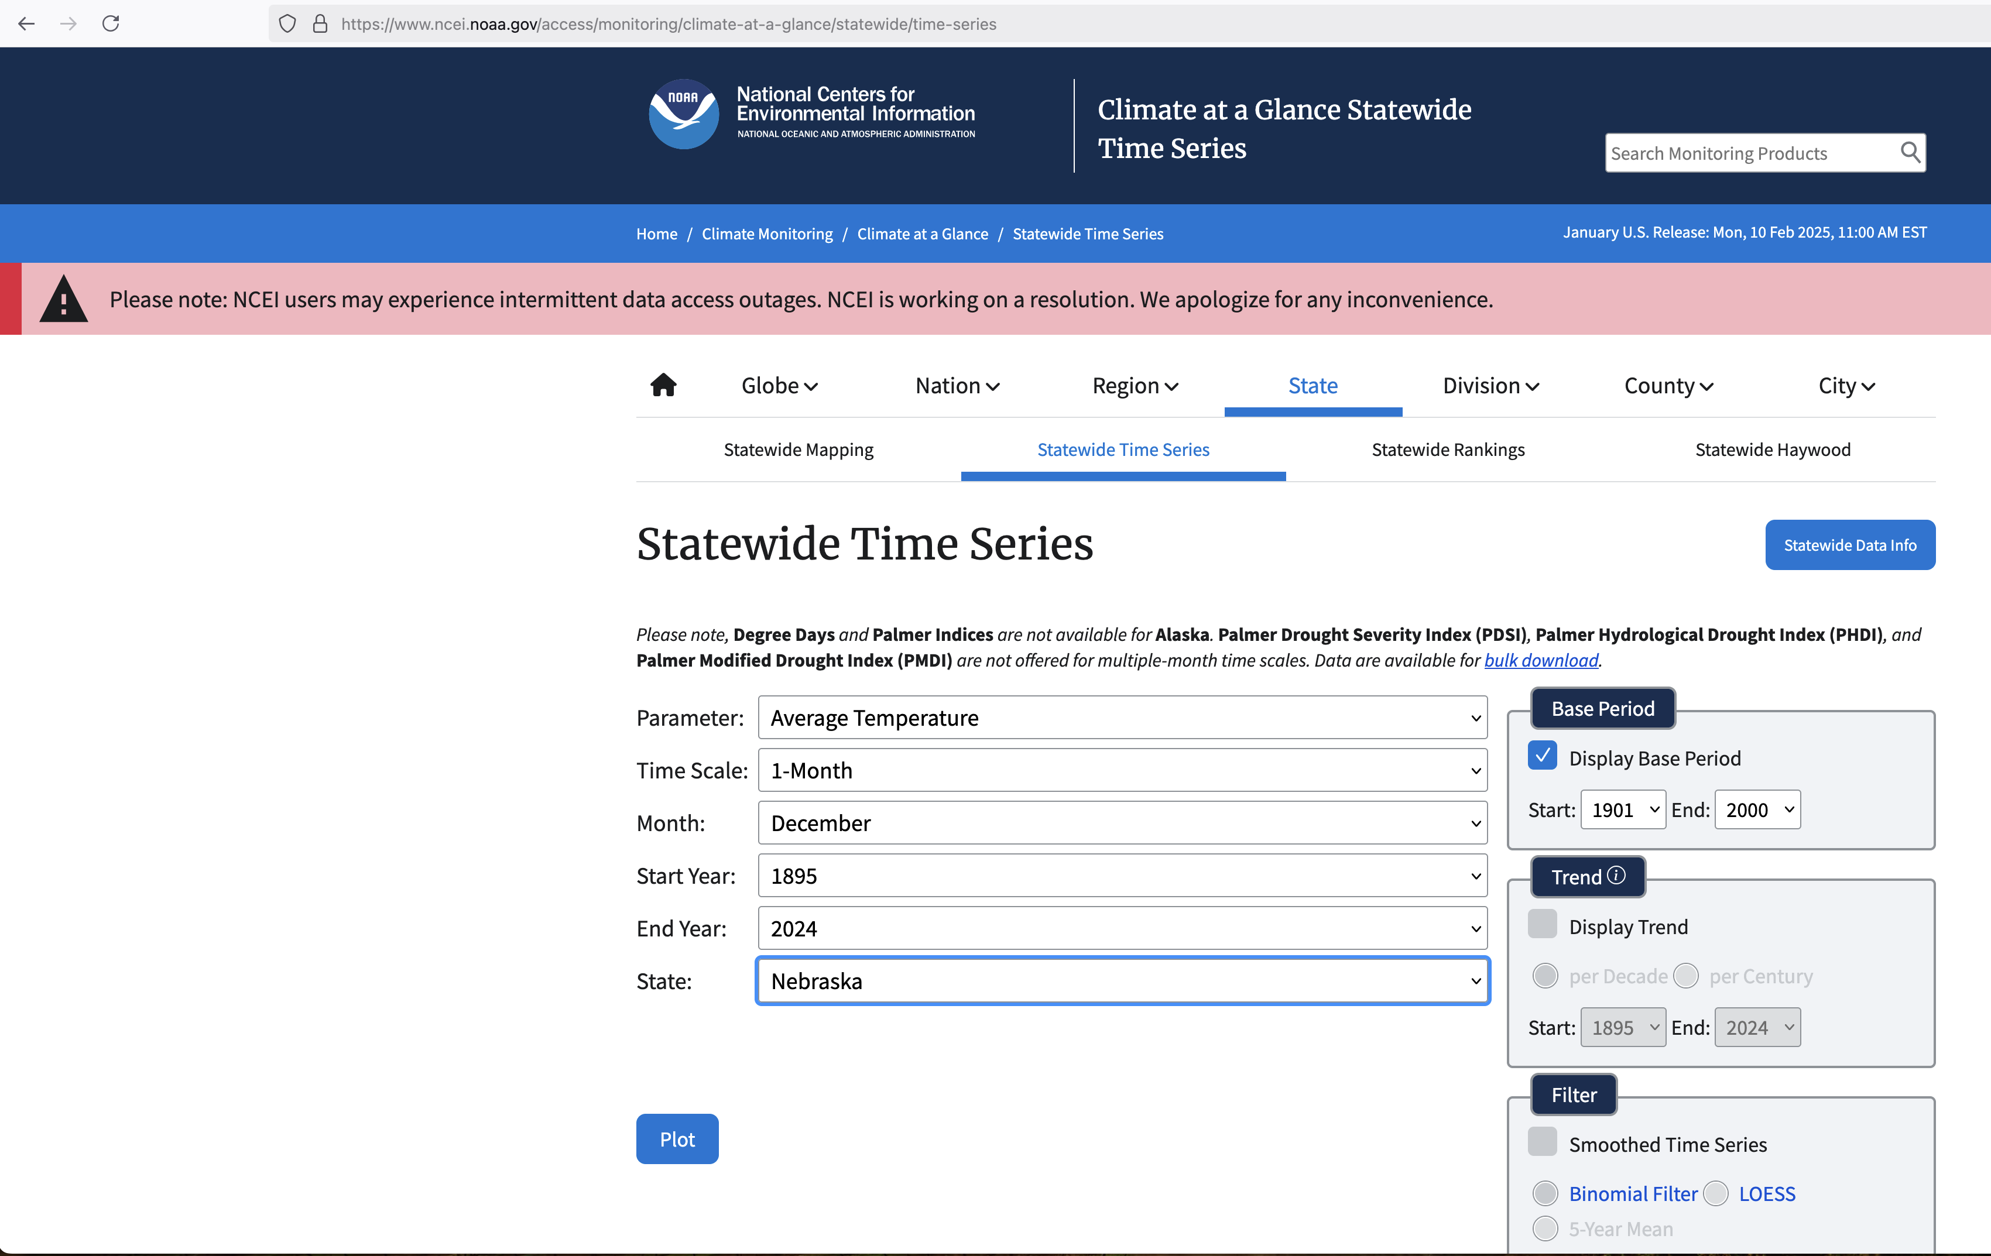
Data Sources
NEBRASKA STATE CLIMATE OFFICE
ACIS
Climate at a Glance
https://www.youtube.com/watch?v=MLi6LYcIiSc

Slide 23
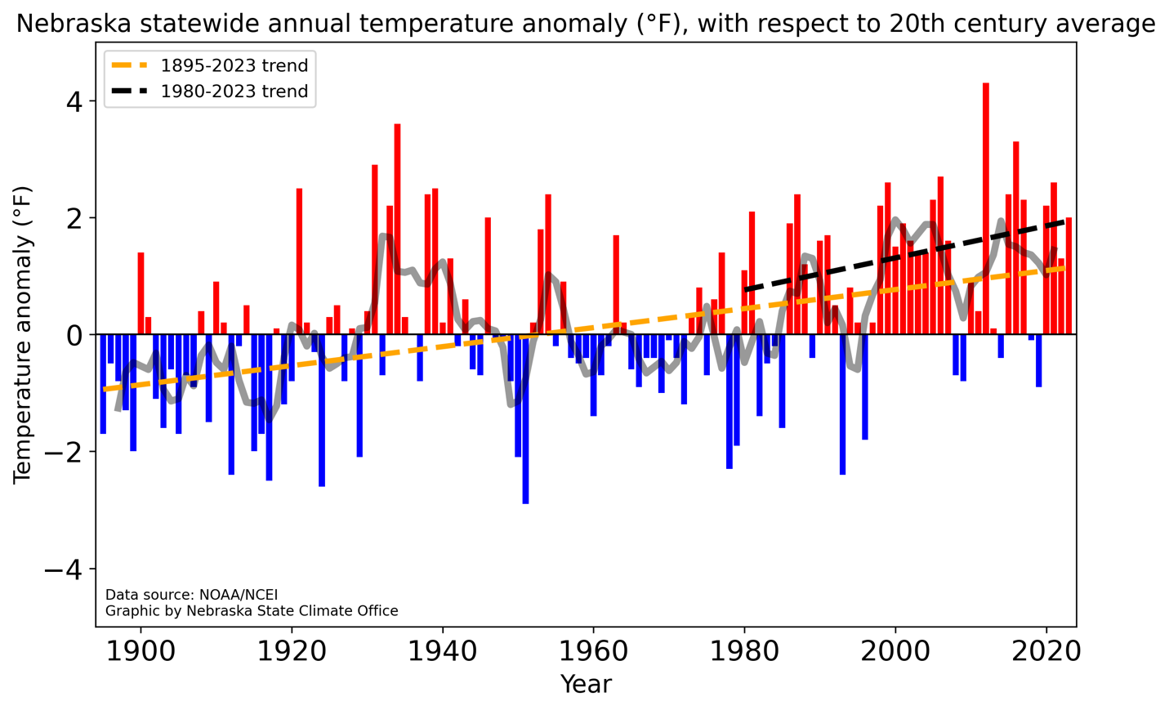
Annual temperature trend
NEBRASKA STATE CLIMATE OFFICE
Source, NCEI

Slide 24
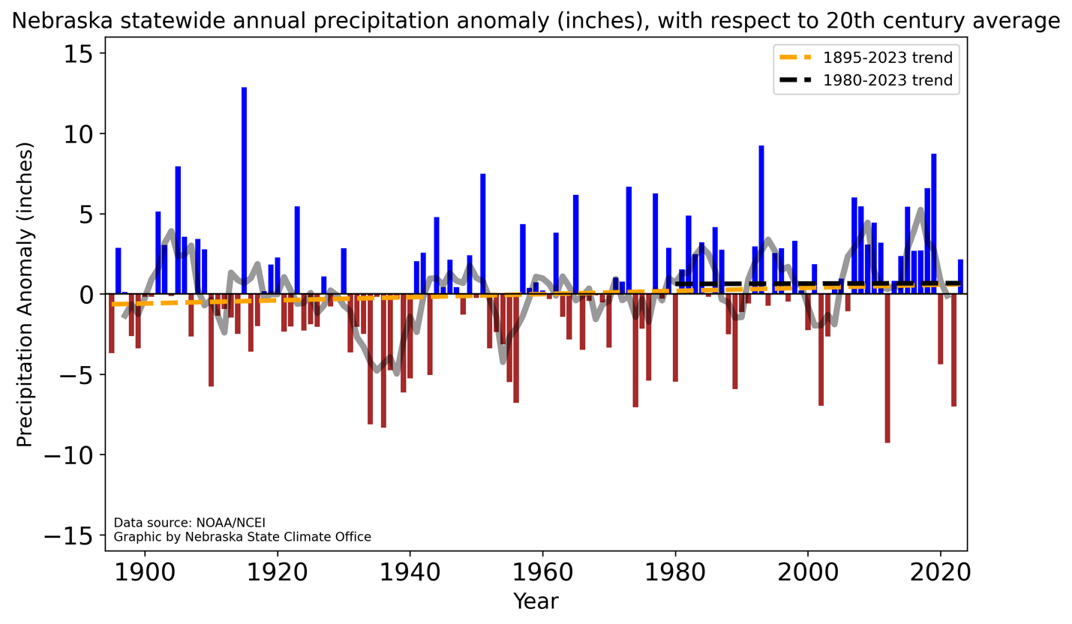
Annual precipitation trend
NEBRASKA STATE CLIMATE OFFICE
Source, NCEI

Slide 25
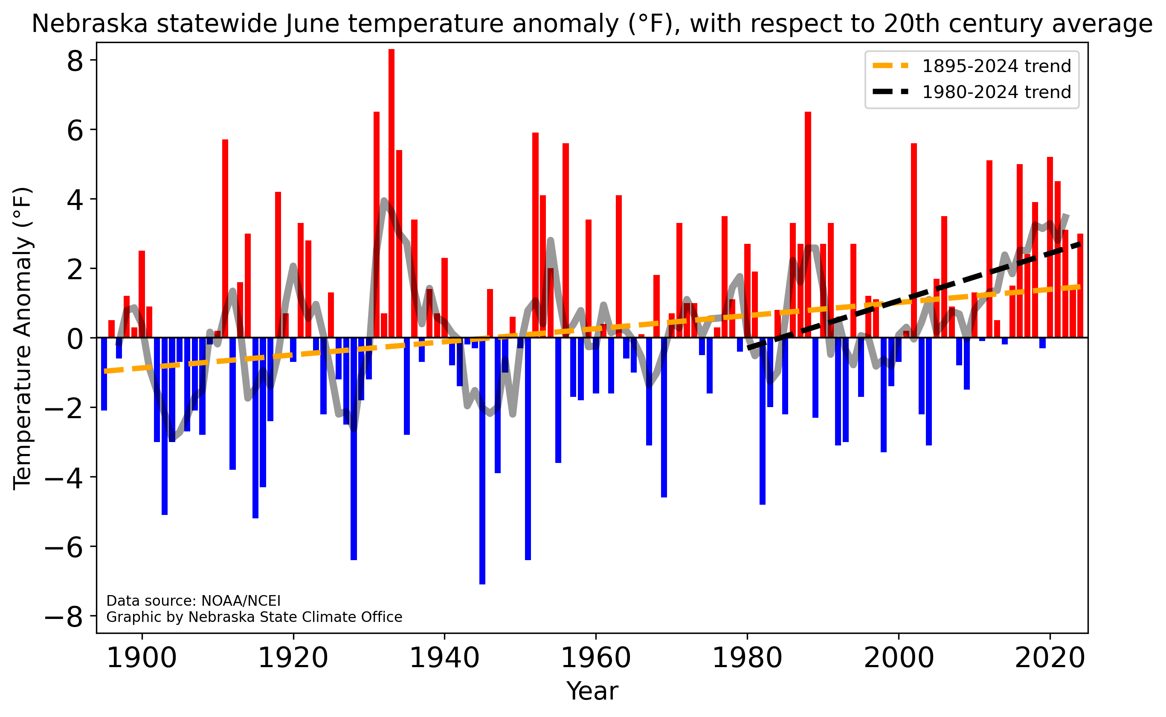
June warming quickly
NEBRASKA STATE CLIMATE OFFICE
Source, NCEI

Slide 26
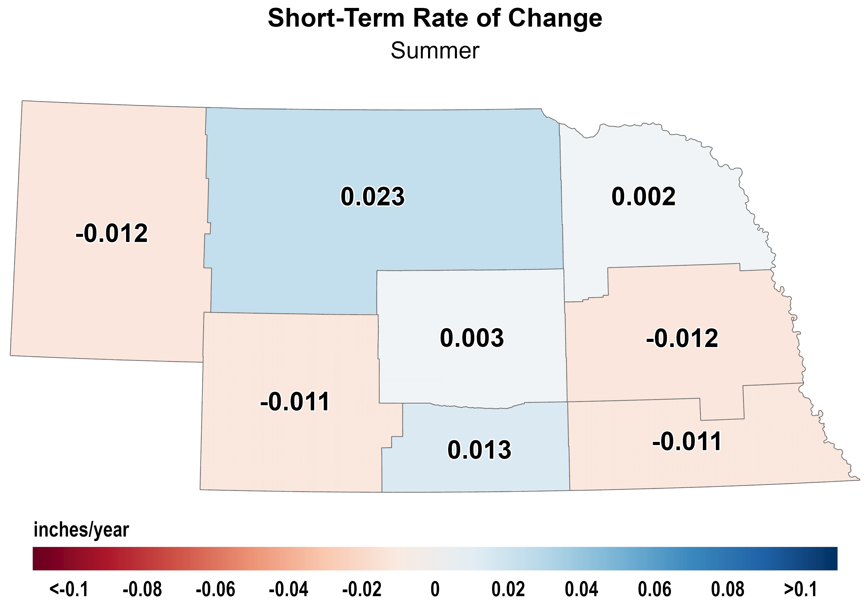
Summer precipitation 1980-2023
NEBRASKA STATE CLIMATE OFFICE
Source, NCEI
Notes:
Here I outlined the similar trends for the Nebraska and global annual average temperature. I also point out the high variability in Nebraska and difference in regional vs. global scales. I use the analogy that global change is like an escalator that is increasing at an accelerating rate. The variability is like we jump up or down a few steps while still going up.

Slide 27
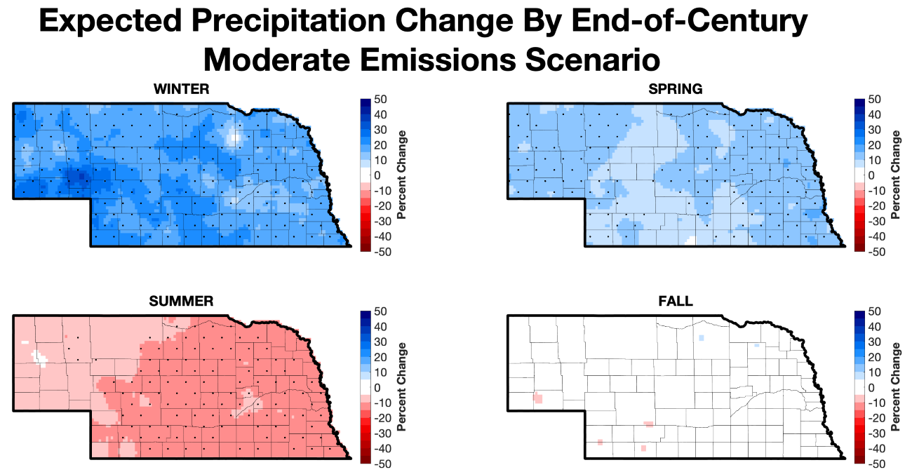
Nebraska temperature projections
NEBRASKA STATE CLIMATE OFFICE
Source, CMIP6

Slide 28
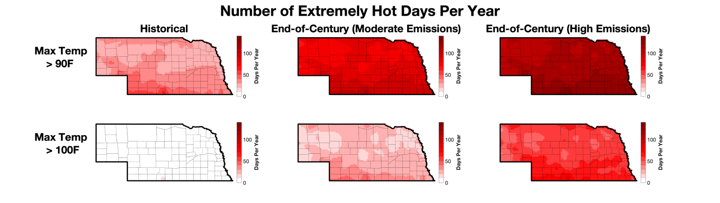
Nebraska temperature projections
NEBRASKA STATE CLIMATE OFFICE
Source, CMIP6

Slide 29
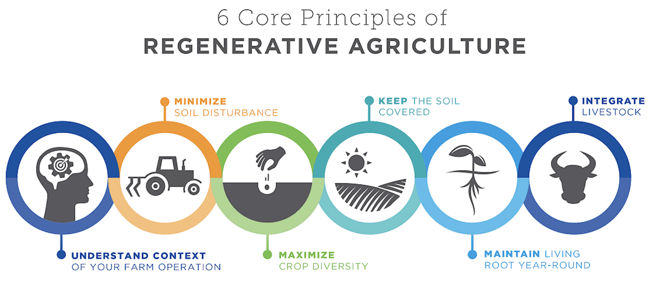
Regenerative vs. Extremes
NEBRASKA STATE CLIMATE OFFICE
Source, Noble Research Institute

Slide 30

Contact
Email: ehunt2@unl.edu Phone: 402-617-4190
Find me on: Market Journal on Saturday mornings, Crop Watch podcast, and Nebraska State Climate Office website
TikTok: @neclimateoffice
NEBRASKA STATE CLIMATE OFFICE
Contact: ehunt2@unl.edu 402-617-4190
Find me on: Market Journal on Saturday mornings, Crop Watch podcast, and Nebraska State Climate Office website
TikTok: @neclimateoffice

Slide 31
References
NEBRASKA STATE CLIMATE OFFICE
https://nemesonet.unl.edu/ (1)
https://prism.oregonstate.edu/normals/ (1)
https://mrcc.purdue.edu/freeze/freezedatetool (10)
https://hprcc.unl.edu/agroclimate/cligrow/ (13)
https://www.fao.org/4/x0490e/x0490e06.htm (15)
https://cropwatch.unl.edu/2024/fire-safety-during-harvest-season-essential-tips-farmers/ (21)
https://xmacis.rcc-acis.org/ (22)
https://www.ncei.noaa.gov/access/monitoring/climate-at-a-glance/ (22)
https://wcrp-cmip.org/cmip-phases/cmip6/ (26)
https://www.noble.org/regenerative-agriculture/6-soil-health-principles-for-regenerative-cattle-ranches/ (29)

